Slide 1

Athanasius the Great
Alexandria
Module 2B
St. Mary’s Byzantine Catholic Church
Adult Education Series
Rev. Deacon Mark Koscinski

Slide 2
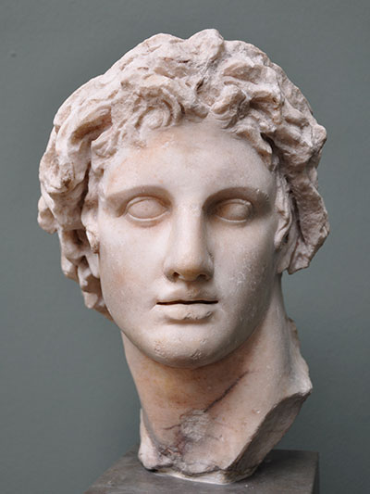
Alexandria
Founded by Alexander the Great in 331 B.C.
It was one of several cities to bear his name, but certainly became the most famous
Continued as capital of Egypt through the Roman era, until 641 A.D when the capital was moved to a small city eventually subsumed into Cairo

Slide 3
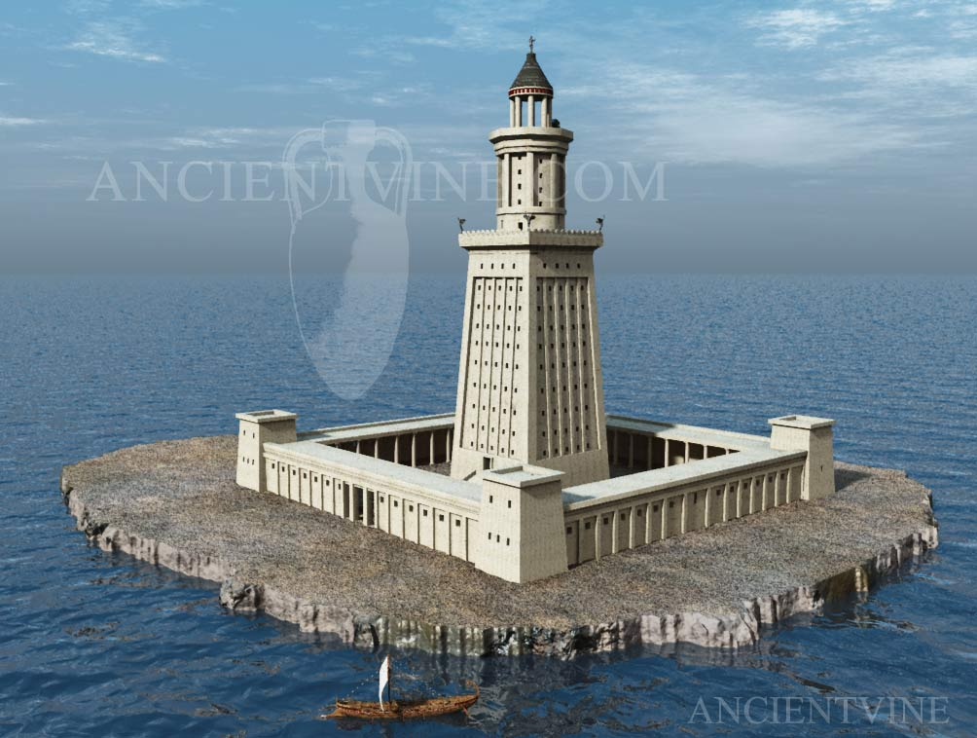
Famous Landmarks
The Lighthouse is one of the Seven Wonders of the World.
Built by the Ptolemies in the Third Century
Was approximately 400-450 tall
Damaged by earthquakes, it was abandoned in the 13th/14 centuries
A symbol of the grandeur of Alexandria

Slide 4
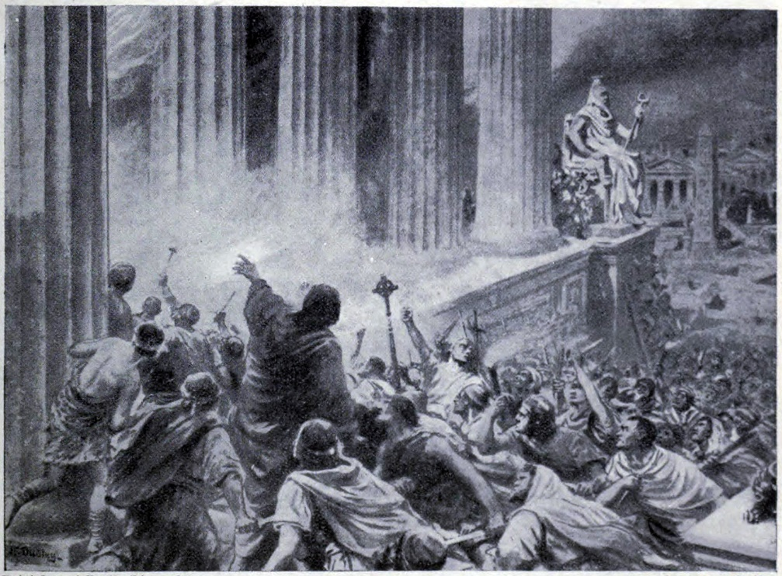
The Library
The myth was there were “burning of the library”
In fact, there were probably several
  Julius Caesar 48 BC
  Aurelian 270-275 AD
  Burning of the Serapeum in 391
    Final portion of library destroyed.

Slide 5
Alexandria---The Port
Becomes third largest city of the Empire after Rome and Constantinople.
Outlet for annual grain shipments to Italy and Constantinople.
Two harbors handled shipments coming down the Nile as well as from the Oriens.
Laid out in a grid pattern.
Few remains are left
Population was generally bilingual in Greek and Coptic.
Large monasteries supported charity workers.
Attracted the best minds.

Slide 6
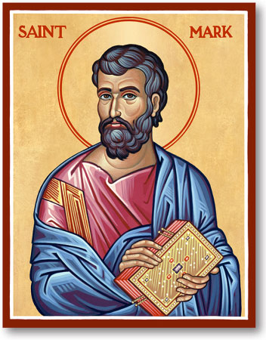
Alexandria—The Patriarchate
In addition to using the term pope, the first use of the term archbishop could be here.
Mentioned in the Council of Nicaea as the among the three Apostolic sees, its importance eventually gave way to Constantinople in 381.
Monophysitism caused its humiliation in 451 at the Council of Chalcedon.
The patriarchate split into two parties as a result.

Slide 7
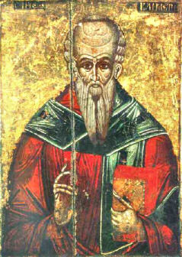
Alexandria—The Theological School
Typified by Clement of Alexandria and Origen
Based on Platonic tradition, the school focused on the allegorical meanings of the Bible.
Focused on the Divinity of Christ rather than His Humanity
Athanasius was a disruption and not a continuation of this school of thought.

