Slide 1

Athanasius the Great
Introduction to Athanasius
Module 1A
St. Cyril and Methodius Byzantine Catholic Seminary
Byzantine On-Line
Deacon Mark Koscinski
Notes:
If you are looking for the course on Athanasius the Great, you have found the right place. This the St. Cyril and Methodius Byzantine Catholic Seminary course on Athanasius the Great, one of the most influential lights in the Eastern and Western Church.

Slide 2
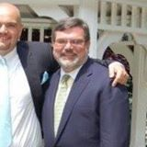
Deacon Mark Koscinski CPA D.Litt.
BA Economics with High Honor
MBA Professional Accounting
CPA State of NJ
MS Taxation
D.Litt. Eastern Christianity
Father of three children. One foster daughter as well.
Notes:
I am Deacon Mark Koscinski. I live in Northern NJ. By way of education, I hold a bachelor’s degree in economics from Rutgers College in NJ with high honors; an MBA in professional accounting from Rutgers. My worse mistake in education was obtaining a Masters degree in taxation. Finally, I earned my M.Litt. and D.Litt. In Eastern Christianity from Drew University in Madison NJ. For those of you that don’t know Drew University, it is a Methodist seminary with a college attached to it. I would like to think that this allows me to take a little bit of a unique look at Eastern Christianity, sometimes through a Protestant lens.

Slide 3
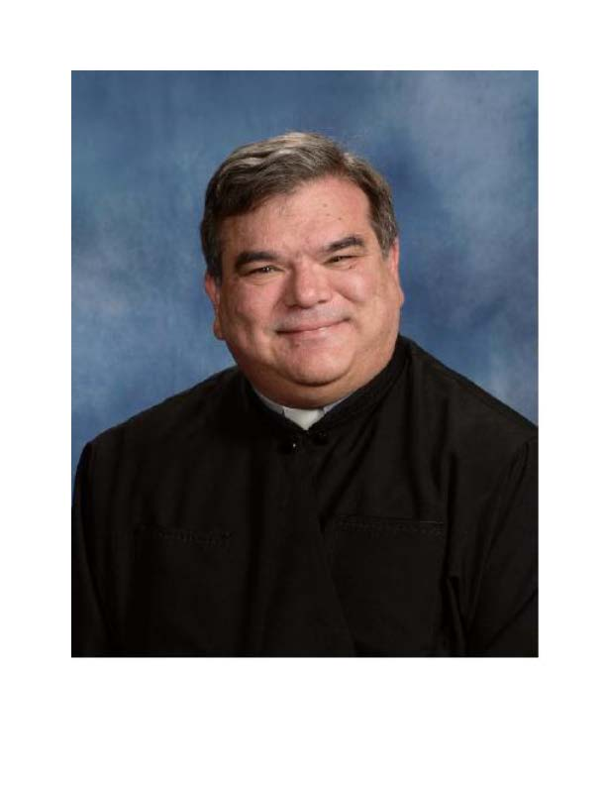
Deacon Mark Koscinski CPA D.Litt.
Attended Diaconal training 2002-2007
Tonsured as a cantor/lector in 2005
Ordained as a subdeacon and deacon in 2007
Served as the Finance Officer of the Eparch of Passaic
Administrator of a parish
Currently assigned to St. Mary BCC in Hillsborough NJ
Notes:
On the Church front, I attended Deacon training for four years beginning in 2002. I was tonsured into minor orders on December 6, 2005 by Bishop Andrew Pataki of Blessed memory. I was ordained deacon on July 1, 2007. Up until recently I was the second junior deacon in the diocese until recently.
I have served at the eparchy of Passaic as the Finance Officer and as a parish administrator for eight months. Currently, I am assigned to St. Mary’s Byzantine Catholic Church in Hillsborough NJ where Fr. Ed Cimbala is the pastor.

Slide 4
Requirements of the Course
Do the Readings!
Prepare a one page paper for the next six classes.
  Due six p.m. every Monday
  One inch margin minimum
  I will stop reading after one page
Prepare a book review for the final class.
  Two page maximum
  Any academic format acceptable
  Same instructions as above
Notes:
We are going to cover a lot of material in a very short period of time. Therefore, it is critical for you to do the reading. Since I only have a short period of time I will focus on supplementing and explaining the material rather than going over the material in detail.
Since this is a college level course, we will need to have some written material to grade on. Your main responsibility of the course will be to write six one page papers. A professor of mine at Drew like to do this. I always believed it wasn’t that tedious of a requirement, but forced you to focus on the kernel of the material.
We will talk about the book review in a little bit.

Slide 5
Requirements of the Course
Postings in the Forum
  There will be one or two discussion questions posted for every class
  Those taking the class for credit should make two substantial posts to each forum in each class.
    Substantial postings DO not include postings such as “I agree”, “Yep” or “No”
Bulletin Board
  I will be posting comments frequently so check it frequently
For Those Auditing the Course
  You are invited to participate in all aspects of the course, including papers and posting.
Notes:
It is also important we have interaction. That will mainly be by the use of the forum. I will post one or two discussion topics for each class. You will be required to make one or two substantive posts to the forum. I have some whimsical examples of what is not an acceptable post.
I like to post material to the bulletin board on a frequent basis. Please take a look at tit when you can. It will include course mechanics material as well as material for the class.

Slide 6
Reading Requirements
Papers on the Athanasian Creed
  I will post them to the course website
The Life of Antony
The Letter to Marcellinus
Treatise on the Incarnation of the Word
All of these except for the first reading are available on-line in order to save money.
Notes:
I have done some original work on the Athanasian Creed. I will be posting it on the course page.
The other material is available on the internet. I don’t want you to spend any money on books for the class. There is plenty of material on line for us to use.

Slide 7
Supplemental Readings
New Advent
New Advent
Alexander of Alexandria
Anthony of the Desert
Arianism
Basil the Great
Basil, the Rule of St. Basil
Constantine the Great
First Council of Constantinople
Nicene Creed
http://newadvent.org/
Somewhat dated, but still a wonderful source for all things Catholic.
Notes:
In addition, there are some articles on the website New Advent that we will use as supplemental reading material in the course. The encyclopedia is dated, but it is still a wonderful source of information for all things religious.

Slide 8
Course Mechanics
Office Hours
Grading
Monday 9-11
Tuesday 9-10
  I will be online in the chat room
Email: mark_Koscinski@yahoo.com
  It is easiest to try and get me there, since I visit clients during the work day.
Each paper worth 10%
  Grading will not only be on content but also for grammar
Book review worth 20%
Participation in Chat Room and Bulletin Board: 20%
Notes:
My office hours are posted. I will be in the chat room at the designated times. I can also be available in the chat room by arrangement.
The easiest way to get me is through my email since I move around a lot because of client commitments. I can also arrange to teleconference as well.
The grading is specified above. I think it is pretty self explanatory, so I wont spend much more time on it.

Slide 9
Paper Possibilities
Guidelines
Topics
Pick any Six
Other topics you are interested in are open but please clear them in advance
These will require some outside research
Basil’s Rules of Monasticism
Arianism
Meletianism
Alexander of Alexandria
Lucian of Antioch
Deification
Constantius II
First Ecumenical Council
Notes:
I have spoken about the paper requirements previously. The papers are due on Monday 6 p.m. every week. I have suggested topics for you to write on. I will be adding paper topics throughout the course as well on the bulletin boards. If none of these wow you, feel free to contact me to ask for others. The object of this is for you to not only learn but to have fun. So if a topic wows you, feel free to share one with the class. You will need to do a little research also to do a good paper, of course.

Slide 10
Book Review
Pick any book written by Athanasius and provide a review of two pages.
Any book about Athanasius can also be used as a substitute.
Any suitable academic format is acceptable.
Due on the last day of the class.
Notes:
Athanasius was a prolific writer. Pick one his works, read it, and provide a book review on the subject. There are many acceptable academic formats. Anyone will do. This is due on the last day of the class.
If you find a good book on Athenasius, you can also read it and do a review on it. Again, the goal is to let you explore this vast topic of the man known as Athanasius the Great.

Slide 11
How Are We Going to Approach
This Course?
5 Ws and H of Journalism:
  Who was St. Athanasius?
  What did St. Athanasius become to the Church?
  Where did St. Athanasius live?
  When did St. Athanasius live?
  Why did St. Athanasius support Christian Orthodoxy?
  How did St. Athanasius become what a Doctor of the Church?
Notes:
How are we going to attack the subject matter? I always liked the five rules of journalism.
For the rest of this module we will take a look at the What question. What has St. Athanasius become for the Church?

Slide 12
The Achievements of St. Athanasius
Attended the First Ecumenical Council as a deacon with Archbishop Alexander of Alexandria. He was a major force in the outcome of the Nicene Council
Produced the first list of the current biblical canon
Major opponent of the Arian heresy
Proponent of Deification
Notes:
Athenasius is noted for many things. These are some of the more prominent.
He attended the First Ecumenical Council as a deacon of Archbishop of Alexandria. He was a major factor in the outcome. Athanasius was a great scholar of the Scriptures. He produced the first list of the current biblical canon. His letter to Marcellinus is still considered a masterpiece of biblical exegesis.
Athanasius was an opponent of Arius and the Arian movement. He is a major reason why the world is not today Arian. .
Athansius was also a proponent of the deification, a concept we will deal with later in this course.
We will see later on there was another, a darker view of Athanasius. There were perhaps times he did not operate like a Boy Scout. He had to defend himself from many charges and stand trial.

Slide 13
The Great Doctors of the Church
Latin Doctors
Greek Doctors
St Ambrose
St. Jerome
Gregory the Great
St. Augustine of Hippo
Athanasius the Great
Basil the Great
Gregory the Theologian
John Chrysostom
Notes:
The illustrious career of Athanasius is was rewarded by being named a great doctor of the Church. Those in orange were contemporaries of Athanasius the Great. He had an active communication with Basil the Great, the archbishop of Caesarea in Cappadocia. Gregory the Theologian was the best friend of Basil the Great, and was later Archbishop of Constantinople.

Slide 14
Lifelines of The Greek Doctors
Notes:
I like to put the lifelines of various luminaries on charts. It give you some perspective about where there might be some interactions, and to discern trends in the biography of our hero—in this case, Athanasius.
The first thing we can see is that Athansius is the first of the Doctors. We know that there was interaction between Basil and Athansius. WE can also discern a trend. As the Christians persecutions ended, Christianity begins to flourish. Part of the floroushing is the growth of Christian writing. My thesis is that this flourishing is due to the relatively gentle era Constantine the Great created.
We also have to keep something else in mind. If we just stop there, we are making a grave mistake that historians sometimes make. We don’t see what some of the anxieties are. We know things worked out and the Roman Empire stayed Christian. Yet, these great thinkers did not know that. It could have gone just the other way. By 360 AD the Empire was in the hands of an avowed pagan. Julian died after a short reign of only a couple years. Suppose he had lived longer. St. Athanasius could not have known in 360 that Julian would only live for a short period. He felt the tension in the air. Compound that with the heresies he was combatting, the fate of orthodox Christianity could not have seemed that secure.

Slide 15
Lifelines of The Latin Doctors
Notes:
The Latin Doctors were generally even later than the Greek Doctors. Nevertheless, we know form the writings of Augustine he was familiar with Athanasius.

Slide 16
Lets See How Tenuous Things Were….
Constantine: 305-337
  Sends Athanasius into exile
  Waffles on dealing with various heresies
Sons of Constantine: 337-360
  Definite Arian leanings among some
Julian: 360-363
  Tried to return the Empire back to paganism
WHO CAN FEEL SECURE IN THIS ENVIRONMENT?

Slide 17
Feast Days of Athanasius
January 18
May 2
Major feast day
One day after Antony of the Desert
This day commemorates his return from exile in 345 when the usurper Gregory dies.
Shared with Cyril of Alexandra, an opponent of Nestorianism
Notes:
Athanasius is commemorated by two major holidays. The first is shared with Cyril of Alexandria, who he is often depicted with in icons.

Slide 18
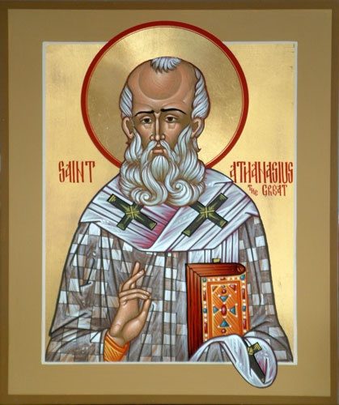
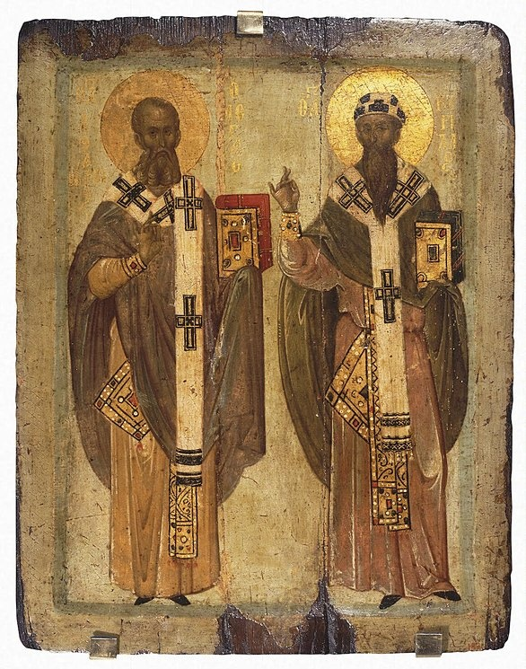
Athanasius in Iconography
St. Athanasius
Athanasius and Cyril
Notes:
Athanasius is often shown as a balding square jawed bishop. He is often depicted with Cyril of Alexandria, a later Archbishop of Alexandria who was the major opponent of another heresy.
We will hold things here for this module. Have a wonderful week, and I hope to see you in the chat rooms.

