Slide 1

Athanasius the Great
The Life of Athanasius
Module 2A
St. Cyril and Methodius Byzantine Catholic Church
Byzantine On-Line
Rev. Deacon Mark Koscinski CPA D.Litt.
Notes:
I welcome you back again to Byzantine OniLines presentation of Athanasius the Great. I am deacon Mark Koscinski. First, a little recap of modules 1a and 1b.
Athanasius was a great luminary of the church. He was a primary theologian for the doctrine of deification, or theosis; he produced the first list of our NT canon: a staunch opponent of Arianism and orthodoxy; producer of the Athanasian Creed; He was the archbishop of Alexandria, an area of the world vial to the Roman Empire and vital to the Church since it was an apostolic see. The Empire itself just shook off persecution of Christianity, and was now moving towards making Christianity its predominant, but not yet official religion.

Slide 2
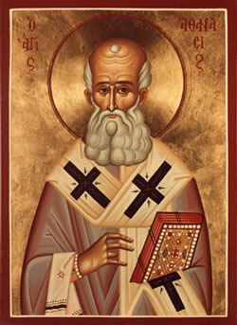
The Life of Athanasius
Born: 293-298
Ordained deacon: 319
Attends First Ecumenical Council as deacon for Alexander: 325
Elected Bishop of Alexandria in a contested election: 328
Spends 18 years, or over one third of his episcopate in exile.
Tenacious, dogged in belief.
Dies: 373
Notes:
Lets look at the bare details of his life. Athanasius was born in the last decade of the third century. He was ordained a deacon in 319, and shortly thereafter attended the First Ecumenical Council. He was a fierce opponent of the Arianism heresy, which we will take up in future modules. In a fiercely contested election, he is elected bishop in 328. He reigns over the large see of Alexandria for about 45 years. These were tumultuous years. He spent 18 years in exile from his see. This is over one third of his entire tenure as archbishop of Alexandria.
His reputation precedes him, and his tenure as archbishop starts out very shaky, He receives a letter from Constantine that says I will depose you if I hear you are excluding people you should admit—such as reconciled Arians and Meletians.

Slide 3

Athanasius
When asked by a monk how God the Father and Jesus could be on God…
He responds: Like two eyes, one vision.

Slide 4
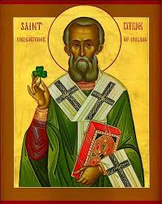
Athanasius
Not as pithy as St. Patrick using the shamrock to explain the Trinity, but pretty quick nonetheless.

Slide 5

Saint or Sinner?
Accused of murder
Accused of rape
Accused of halting grain shipments
Accused of destroying sacred vessels.
Accused of using thugs to secure his election as bishop.
Notes:
The object of this class today is to ask the question: Who was St. Athanasius? Was he a Saint, a sinner, or both, or something else.
In the course of his career, he is accused of murder, mutilation, rape, threatening the peace of the empire; destroying sacred articles; disobeying imperial edicts, hiring thugs and using the imperial garrisons in Alexandria to get his way, and a host of other things I am sure.
There are certain positive things you can say about Athanasius as well. He was a highly educated and cultured man. He was confidant in his faith, and did not waiver. Much to the chagrin of emperors and fellow bishops.

Slide 6
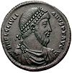
Exiles
Exiled five times.
First exile was under Constantine for threatening to halt grain shipments
Also exiled by Julian for resisting the ban on Christians teaching of classics.
In short, Athanasius was a general pain to all of the emperors
Notes:
He was exiled five times. Putting the exiles to good use, he would write, creating the Life of Antony. This particular book, his most famous, was written during his third exile, from 355-362. He had a knack for torking off the Emperor, no matter who the Emperor was. He got under the skin of Constantine the Great, who first exiled him; Constantius, his son, and even under that of Julian, who attempted to turn Rome back to its pagan roots. He was an equal opportunity itch, both to Christian and pagans alike.
We see here a coin with the face of the Emperor Julian. Socrates the Historian tells an amusing story. When they are coming to pick him up, Athanasius recites a little poem: Let us retire for a brief while, my friends. Tis but a little cloud, and soon will pass. Athanasius tells his colleagues to then turn back and tell his pursuers to hurry up and they can overtake Athanasius. Athanasius then secretly turns back and returns to Alexandria, where he waits out the persecution.

Slide 7
Exiles
First Exile: 336-337
Second Exile: 339-346
Third Exile: 356-361
Fourth Exile 362
Fifth Exile: 365
First Exile: Threatened to stop corn shipments.
Second Exile: Pope Julius asks why he was not allowed to pass judgment
Third Exile: Writes Life of Antony
Fourth Exile: Exiled by Julian the Apostate
Notes:
The Grain shipment problem is a capital offense. The Neo-Platonist philosopher Sopater was accused circa 331 of stopping the grain shipments via magic. He was beheaded. Athanasius was merely sent to Trier.

Slide 8
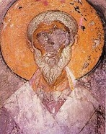
Alexander of Alexandria
Legend has him seeing Athanasius performing a baptism.
Opponent of Meletius and Meletianism
Opponent of Arius and Arianism.
Predecessor to Athanasius as the archbishop of Alexandria.
Notes:
It is impossible to talk about Athanasius without talking about his predecessor, Alexander of Alexandria. He was as impressive as Athanasius in many ways, including his stubbornness. There is the famous story of Alexander being imprisoned during the persecutions, and he happens to share a cell with Meletius, the head of the local Donatist group. Rather than bonding together as prisoners, Alexander hangs a sheet up to divide the room so he wont have to see Meletius. You can see where Athanasius gets a little bit of his spark. Alexander was also a fierce proponent of orthodoxy, and is also revered as a saint. He dies before the either the Meletian or the Arian controversies come to a head.

Slide 9
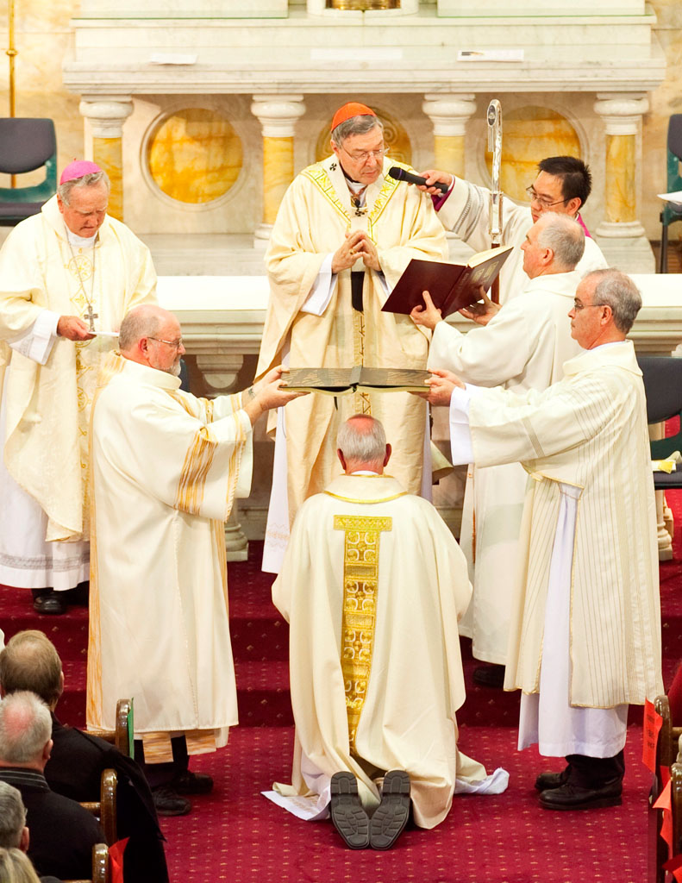
Accused of Irregular Consecration
Athanasius was elected bishop May 21, 328.
Dashed the hopes for peace in the Egyptian Church
He was intransigent on matters of doctrine
Philostorgius the historian says the consecration happened in a dark part of the Cathedral with only two bishops ordaining Athanasius
Notes:
At the time Athanasius is elected archbishop, the Egyptian Church was rent was dissatisfactions and stresses. His election is contested. One historian, who is not so favorable to Athanasius says his consecration is held in the dark recesses of the cathedral, with only two bishops performing the consecration. This is never proven, because if it were true, Athanasius would have a problem. The historical tradition says every bishop in the province should take part in the consecration, or if not, at least three to show the universal acceptance of this bishop. The first ecumenical council at Nicaea also promulgated a canon to that effect.
However, it seems this is going to be the least of his problems. His opponents have set their eyes squarely on him, and have put a bullseye on his back. This is mainly due to his outspoken defense of orthodoxy at the ecumenical council. Sadly, the council did not solve the Meletian or the Arian problem with its decrees. They go on for decades. Indeed the Arian issue goes on for several hundred years more.

Slide 10
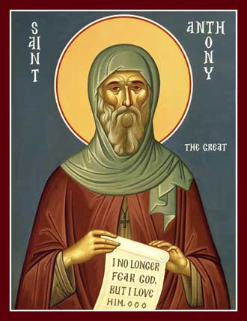
Black Magic
Chapter 79—Life of Antony
Icon of St. Antony
Tell us, where are your oracles now?
Where are you incantations?
Notes:
One of the marks of Egyptian society is its belief in black magic. We can see it in several places. We are going to study the Life of Antony in depth, but I just wanted to make reference to this quote for today’s purpose.

Slide 11
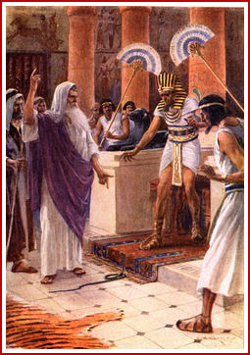
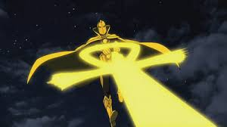
Popular Manifestations of the Belief in Egyptian Magic
Aaron vs the Pharaoh
Dr. Fate
Notes:
One doesn’t have to look far for the belief in the potency of Egyptian magic. Look at the story of the famous duel with the wizards of Egypt that is the Bible. Here we have a portrait of Aaron fighting with the Egyptian priest. He of course cast his rod to the ground to turn it into a snake. The Egyptian priests were also able to make their rods into snakes as well.
Even in modern society there is a strong belief in Egyptian magic. On the right is a picture of a DC comic book character named Dr. Fate. He is a very powerful Egyptian magician whose spells often take the shape of the ankh.

Slide 12

Accused of Black Magic
Black magic was an everyday belief in Egypt.
The most potent talisman was a hand.
Athanasius is accused of mutilating a Meletian bishop to obtain his hand.
He is then accused of killing him.
A hand is brought forward as evidence against him.
Notes:
However, the most potent talisman in Egyptian religion is the right hand. Athanasius is accused of killing and then mutilating a Meletian bishop in order to use his right hand for casting spells. At his trial in front of a council of bishops, a right hand, supposedly the right hand of the Bishop Arsenius, is brought forward for evidence.

Slide 13
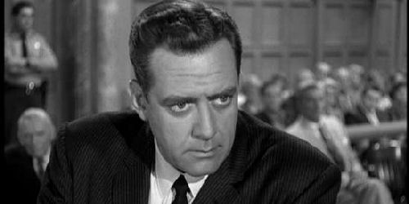
On Trial for Murder
He is accused of murder.
He is acquitted when he produces the man in court, alive and well.
‘Is this the right Arsenius? Is this the man I murdered? Is this the person these people mutilated?—after his murder?—by cutting off his right hand?
Perry Mason and Della Street would be extremely proud of him.
Notes:
He is also accused of murder. However, in a Perry Mason like stunt, Athanasius brings forward the man he allegedly has killed. Not only is he alive, his right hand is intact as well.
READ ABOVE QUOTE
TELL RUSSELL JOHNSON STORY

Slide 14

The Witness Tried to Escape
Arsenius escaped on a river boat from the other side of the building when they came to get him.
Confessions were extorted from two monks, and
Why? BECAUSE HE COULDN’T HANDLE THE TRUTH!!
Notes:
But the story is even more delicious.
Agents of Athanasius are accused of burning the house of Arsenius, fastening him to a column, and then using tongs to mistreat him.
When Athanasius’ agents come to apprehend Arsenius, he is secreted out the building on a boat to escape the agents. Athanasius’ agents eventually get a confession from two months—by force allegedly– and they catch up with Arsenius in Tyre.
Why did Arsenius flee? Because he couldn’t handle the truth….

Slide 15

On Trial for Raping a Consecrated Virgin
Athanasius was accused of raping a consecrated virgin.
He was acquitted when she could not identify him in court.
Notes:
Athanasius is accused of raping a consecrated virgin. He is also accused of giving her gifts for nefarious purposes. He is again acquitted when she fails to identify him in court. As I said, Perry Mason would be proud of him….

Slide 16
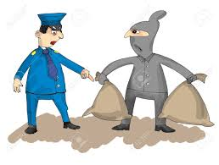
Accused of Pillaging Church Vessels and Buildings
Accused of using thugs to achieve his election.
Accused of using thugs to ransack Arian churches
Accused of not readmitting Arians and Meletians when they are given clemency by the First Ecumenical Council.
IN short, he may not have been a nice guy.
But, he was a man of his time.
Notes:
He is accused of ransacking and destroying churches of the heretics. He is accused of not admitting Meletians and Arians back into communion after the Emperor and the First Council laid down guidelines for their peaceful integration. And on and on and on.
Some of the other charges, as reported by the historian Sozomen: breaking a chalice and throwing down an episcopal chair; imprisoning a presbyter; deposing a bishop illegally; perjury; alienation of the people of Alexandria;
In short, Athanasius may not have been a vey nice guy. But in reality, he was a man of his times and a man who often came up against very powerful countervailing forces.

Slide 17
Imperial Politics
The Jury is In….
The verdict is….
Athanasius is acquitted from all of these charges.
Where there is smoke though, is there fire?
Imperial politics could be very rough.
The Church had only stopped being persecuted in the East a decade before.
You cant read today’s era of toleration back into the Fourth Century.
My sense is Athanasius did things to protect himself.
Notes:
Athanasius is eventually acquitted from all of these charges. But where there is so much smoke, is there at least a small campfire?
I think you cant look back at him with today’s sensibilities. Christianity had only come out of persecuted status in 324. it could easily go back, and it almost did under Julian the Apostate. If he had lived longer, who knows what would have happened? The confessors of the time needed to fight for their existence, and I believe Athanasius did so. I am sure there are things he did that he was not proud of. Yet, what saint doesn’t? In the end, he staunchly defends Christian orthodoxy from its enemies. And that is how the world remembers St. Athanasius.

