Slide 1

Athanasius the Great
Arianism, The Creed, and the Council
Module 3A
St. Cyril and Methodius Byzantine Catholic Seminary
Byzantine On-Line
Rev. Deacon Mark Koscinski CPA D.Litt.
Notes:
Hello again everyone and welcome back. In our last modules, we have discussed some of the highlights—or the low points---depending on how you look at it---of the Life of St. Athanasius. In this module, we are going to fill in the back story as it were---to describe how these things that happened to St. Athanasius came about.
More importantly, we are going to discuss some of the more important events in St Athanasius’ combat against Meletianism and Arianism. These groups were two of the major groups St. Athanasius has to deal with during his life. Today, we will look at how the Church attempts to deal with these major problems.

Slide 2
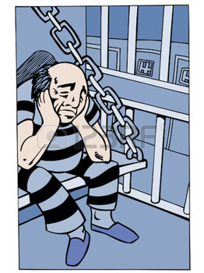
Prologue
In Prison together:
  Arius
  Meletius
  Eusebius Pamphilius
    Later known as Eusebius of Caesarea
    Advisor to Constantine
    Author of the Ecclesiastical History
  Peter of Alexandria
Notes:
But first, as a prologue, lets consider the following scenario. . Imagine a time of persecution. You have in the same jail—indeed, for two of these men, the same jail cell, the following: Eusebius of Pamphylia, who become known as Eusebius of Caesarea—who becomes the influential advisor to the Emperor Constantine, and his biographer; Meletius of Lycopolis, a hard-headed and some would say hard hearted man who does not wish to grant forgiveness to those who apostated during the persecutions; Arius a priest of the archdiocese of Alexandria, and his bishop, Peter. If there was ever a more explosive mix I cant think of one. As for what happens, stay tuned.

Slide 3
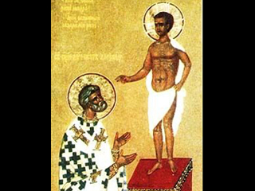
Meletius of Lycopolis
Bishop of Lycoplis
Rigorist was would not compromise on issues
Incarcerated with Peter of Alexandria, the Archbishop
Relations soon turned very sour.
Notes:
Meletius is the bishop of a small see in Egypt, truly insignificant in size when compared to Alexandria. He is a tough rigorist. No forgiveness for those who have apostated. Peter is more gentle. Pretty soon things go south pretty quickly and pretty badly.
The icon of St Peter of Alexandria and of his vision of Christ.

Slide 4
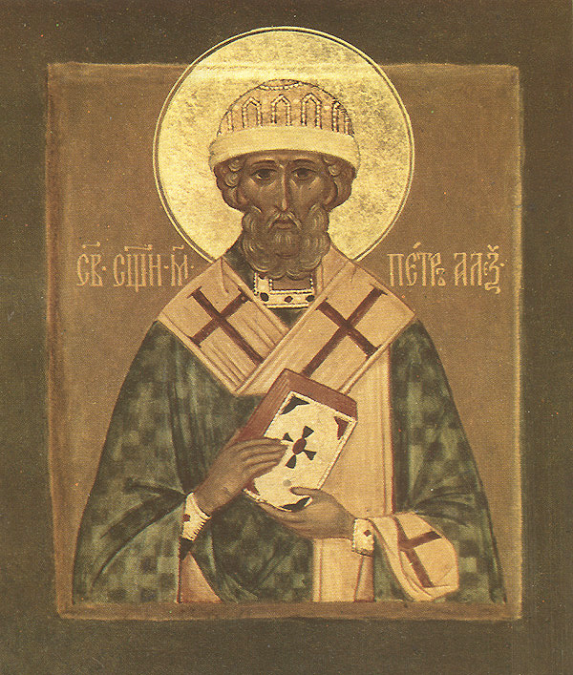
Peter of Alexandria
Elected Archbishop of Alexandria in 300.
Jailed during the persecution of Diocletian
A generous man who did not condone apostasy, but did advocate forgiveness
Notes:
Peter is an upper-class Egyptian, elected in 300 to be archbishop of Alexandria. This not a particularly a good time, as the last great wave of Christian persecution is going to begin under Diocletian, and run be continued on a periodic basis by Licinius and Maxamin Daia. Peter is picked up in this persecution as one wave of it focuses on senior churchmen.
Peter doesn’t condone apostasy, but he is willing to forgive. This doesn’t sit well with a lot of Egyptians, especially with Meletius, who wants to take a hard line on this issue.

Slide 5
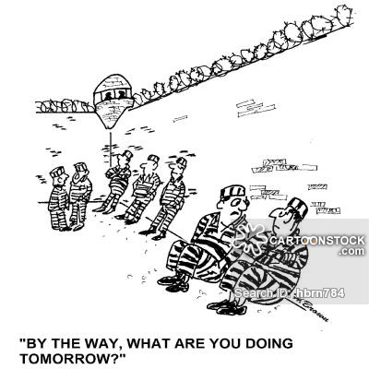
Peter and Meletius
Meletius believed there should be no clemency for those who apostate.
Peter had a blanket put down the middle of their cell, so they did not have to look at each other
Refused to use the same jail yard.
Notes:
Meletius believes there should be zero tolerance for those who handed over the sacred books and vessels. The relationship between the two men gets to be very very strained. They refuse to share the same jail yard, and Peter even has a blanket hung up in their cell so he doesn’t have to look at Meletius.

Slide 6
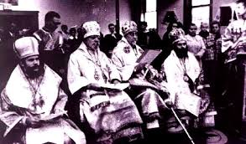
The Egyptian Synod
A synod was held to determine a common Egyptian policy towards the lapsed.
Severe penance was prescribed, but it was possible to obtain forgiveness
The Meletian group was disgusted.
Meletius began to act as archbishop ordaining priests to work throughout the diocese of Egypt.
Notes:
After they are released, Peter calls a synod of bishops to deal with the Meletian issues. He wants to have a common policy towards Meletiansism throughout the diocese of Alexandria. This is a laudable and common sense goal. The synod decrees some pretty stiff penance against the apostates, but does allow for them to return.
This infuriates the Meletians. Meletius is convinced therefore the Archdiocese is now vacant and he begins to act as if he is the archbishop of Alexandria. He begins to ordain clerics not only for his own diocese but for the entire diocese of Egypt. In effect, he starts to set up a rival church.

Slide 7
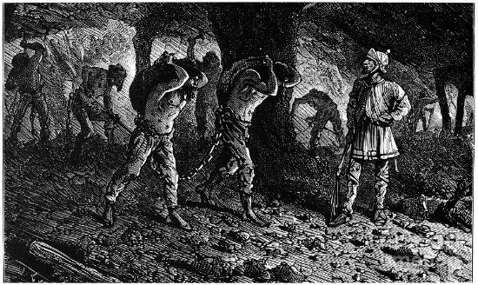
Sent to the Mines
Meletius was arrested and sent to the slave mines of Palestine
He continued to consecrate priests and bishops
Created the Church of the Martyrs.
His cause suffered a temporary setback when Peter was captured and beheaded in 311
The Church of the Martyrs became a serious alternative to the Catholic Church
Notes:
Well, this obviously causes everyone to have problems. He is picked up and sent to the mines of Palestine. For those of you remember the famous movie the Ten Commandments, Joshua is sent to the copper minds of Sinai. These are places you are not expected to come back from. Meletius is hardened even more though and he continues to ordain priests and bishops. He calls his organization the Church of the martyrs, and it continues to grow. It becomes a true rival to the Catholic Church.
Not only does Meletius have sympathy among the population, the battle begins to take on a regional color to it as well. This is becoming a huge problem to the peace of the Empire, and the Emperor is beginning to take notice.

Slide 8
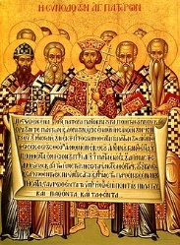
The First Council and Meletius
There was a lot of sympathy for Meletius at the first Council
  He nor his priests were deposed
Meletius was ordered to cease consecrating a competitive hierarchy.
Meletian bishops could succeed to their dioceses upon the death of the catholic bishop if they submitted.
Meletian heresy had fifty years left in it.
Notes:
We will talk about how the First Ecumenical Council come into being later in this module, but for our purposes right now, the Council did take up the question of Meletius. There was a lot of sympathy out there for the Meletians, so the council treated them relatively gently.
Meletius and his followers are not deposed. They are in fact allowed to succeed catholic bishops if they are willing to submit. The Council forbids bishops from interfering in the affairs of other dioceses and mandates that at least three bishops from the diocese be available to be part of the consecration of new bishops. This is in part to prohibit secret consecration of bishops. In short, Meletius is given a pretty good deal by the Council. Yet, the battle goes on for more than 50 years. Athanasius is accused of many heinous crimes, some of which we have discussed in previous module. This is in part because Athanasius doesn’t want to have any part of the Melitians in his diocese, and a rumble breaks out of this issue. Nevertheless because of the actions of St.A, Meletianism becomes a thing of the past within a hundred years.

Slide 9
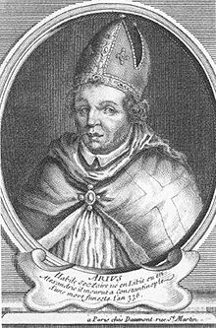
Arius
Was a magnetic personality, and very energetic
Given a parish in the suburbs of Alexandria, his preaching skills brought him many disciples among the clergy, and scandalously, the women.
Arius was tall, and extremely thin.
He dressed very simply and was ascetic.
Studied under Lucian of Antioch
Notes:
Now lets turn to Arius. He was judged to be a man of magnetic personality and extremely energetic. Born in 250 AD, he was already fairly advanced in age when these battles were occurring. Arius was tall, extremely thin, and gaunt. He dressed very simply and was an ascetic. Alexander of Alexandria entrusted him with a parish in the suburbs of Alexandria where he accumulated a large following, especially it was rumored, among the women. One wonders if this was perhaps anti-Arian propaganda later pedaled by the Athanasian camp.
One thing I will note is that the tactics of Arius were very mellow compared with those of his successors. He was tenacious in his defense, but he pursued his goals by and by in church synods and appeals to the imperial court. His followers were much more devious, accusing Athanasius of various crimes, all of which he was acquitted of—even if he did some of them.
Arius was also lucky he lived in a much more genteel era than previously. When he was condemned by various councils, he was not dragged away and beheaded. The same could be said about Athanasius of course. Much of this could be attributed to Constantine the Great. However, even he would often lose patience over arguments he felt were inconsequential.

Slide 10

Arius
An initial supporter of Meletius, who repented.
When Meletius was excommunicated by Peter, Arius objected so violently that Peter was compelled to excommunicate him as well.
Later reconciled again.
Notes:
Arius already had a something of a checkered pass by time he became the major proponent of the heresy named after him. Arius was initially a follower of Meletius. However, he repented. When Meletius was excommunicated by Peter, Arius objected so vigorously that Peter had to deal with Meletius. Arius repented of that as well.
Subsequently, Arius fell under the spell of Lucian of Antioch.

Slide 11
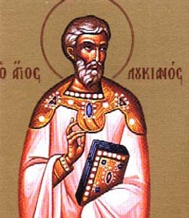
Lucian of Antioch
Lucian taught an entire generation about his own views of Christianity
His followers were intensely loyal to him and to each other.
This group was called the Collucianists, or those with Lucian.
Lucian was from the Antiochian school that emphasized God the Father
Antiochian teaching stressed the difference between the Father and the Son, giving the Father precedence
Arius learned a particular way of looking at God
Notes:
Lucian of Antioch lived from 240 to 312. Like Arius, Lucian was a magnetic person who put together a large following, including the Empress Helena, mother of Constantine. Arius used the term Collucianist,or those who followed Lucius. Lucius was from the Antiochian School of theology. Earlier in this course I mentioned there were two predominant schools of theology at that time: the Alexandrian and the Antiochian. They had two distinct methods of conducting theological inquiry. Among the differences was the Antiochian school stressed the difference between the Father and the Son, giving the Father precedence. While Lucian was not willing to as far as Arius, you can already see the seeds of Ariansim being planted. Arius did not learn a particular doctrine from Lucian but learned a way of looking at the Godhead.
Lucian was never out of communion with the Church. He died as a martyr in 312.

Slide 12
Arianism at its Root
The Senior Partner in the Godhead was the Father
The Son was eternally subordinate to the Father
“There was a time when he was not”
Notes:
At it root, Arianism is a form of subordinationism. The Word is subordinate to the Father. Only God was Uncreated. Everything else was created. That included the Word. If the Word was created, there had to be a time when he was not. That became the slogan of the Arian camp: There was a time when he was not.
In short, the Word was a creature—certainly amongst the highest creatures in God’s creation, but definitely a creature. The Athanasian camp looked upon this with horror. Athanasius believed in the soteriological imperative. Only God can save. Therefore, the Son had to be One with the Father. The Son had to be God in order to save mankind.
The question was how could the Father and the Son be One? What was the logical connection? How could they both be God when we inherited the monotheism of the Jewish religion? That formulation was left to the Council of Nicaea and the creed.
The Athanasian Creed is a longer, more elegant formulation of the Nicene Creed, traditionally attributed to St. Athanasius. I present it to you to show you the depth of the thinking that this issue contributed to on each side. The Christological debates continued for centuries. Arianism was simply the tip of the iceberg. Formulation after formulation.

Slide 13
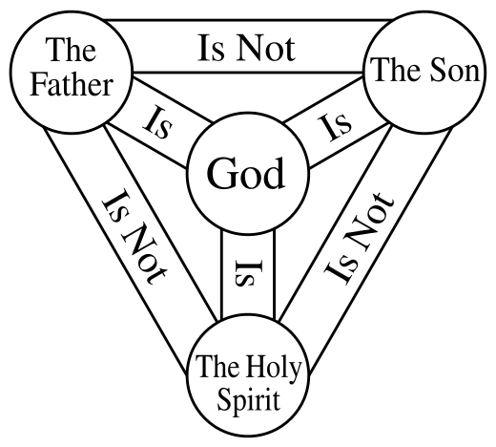
Alexandrian Reaction
This was completely shocking!
God was unchanging
  If Christ was ever the Son of God, He had to be so from all eternity.
  You just cant have God dividing himself at some point in time.
  He wouldn’t be perfect then.
Notes:
The Alexandrians made the point that God is unchanging. You just cant have God dividing himself at some point into two persons. God had to have two distinct persons eternally. This logic works of course if you believe in the soteriological imperative, that only God saves. Under this logic, if Jesus had to be divine, he had to be so from all time. However, if Arius is right, and Jesus is subordinated to the Father, then the Alexandrian logic doesn’t work.
Sometimes though, logic may not work, particularly when we are talking about God. Logic may be a good tool to use to help, but it cant be used to solve issue of revelation. Lets look at another famous formulation attributed to the West.
The Father is not the Son
The Son is not the Holy Spirit
The Holy Spirit is not the Father
The Father is God
The Son is God
The Holy Spirit is God
There is one God.

Slide 14
Progression of Ariansim
By 320, Arius had one bishop, seven priests, twelve deacons and 700 consecrated virgins as followers. Arianism was spreading rapidly.
By this time Arius had become the second ranking priest in the Archdiocese, and Alexander the Bishop began to take notice.
Alexander called for a debate.
This was followed by another.
Arius eloquently defended himself so Alexander did not suspend him
Alexander forbade him to teach until a council of bishops could settle the issue.

Slide 15
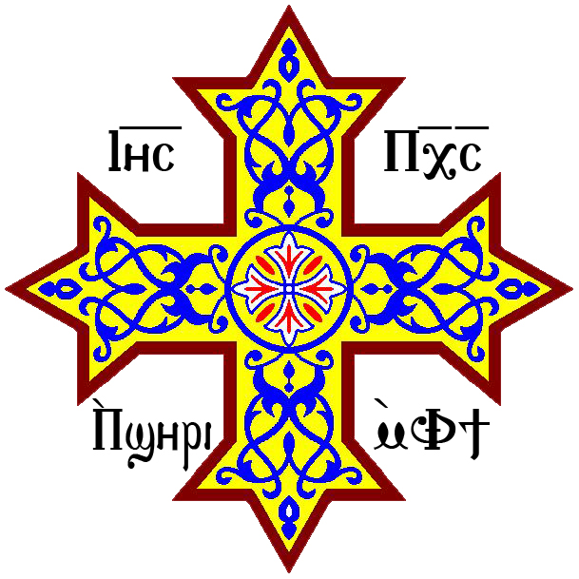
Colluthus
The senior priest in the archdiocese was named Colluthus.
Colluthus was sickened by Alexander’s deliberate approach
He concluded the Church in Alexandria was dead
Colluthus declared himself a bishop and began ordaining priests
It looked like the Church in Antioch was disintegrating:
  Meletians
  Arians
  Colluthusians
The pagans took heart from the chaos.
Notes:
Colluthus, the senior ranking priest in Alexandria seems to be have been fed up with the lack of action from Alexander. He starts to act as if he is the Archbishop of Alexandria, and starts ordaining priests. Later on in this course, we will see how Athanasius uses this situation to insist on the proper church hierarchy in his writings.
Read Quote.
The main point is this. You have people loyal to Alexander, Arius, colluthus, and Meletius running around Alexandria all claiming to be the real church. You need a scorecard to keep track of all of these guys. It looks like the church in Alexandria is fracturing.
Well, we also saw why earlier in the course why peace in Egypt and Alexandria was critical to the Emperors. This situation looked like a powder keg that was going to explode soon. Obviously, it caught the attention of the Emperor Constantine, who didn’t want any trouble in his empire, let alone in Egypt. Now he has four people running around saying they are the bishops of his most prosperous diocese. He acts.

Slide 16
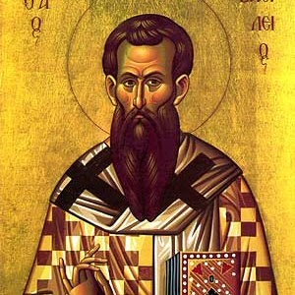
The Local Councils
Alexander’s Council of 100 bishops condemned Arius.
A second council at Mareotis condemned Arianism again.
Arius did not take things laying down
  Wrote to Eusebius of Nicomedia and Eusebius of Caesarea
  They both had Arian leaning and encouraged Arius to continue
Eusebius of Nicomedia called a synod to evaluate Alexander of Alexandria—clearly interfering in another bishop’s diocese
The Nicomedian Synod encouraged Alexander to reinstate Arius.
Notes:
Meanwhile back at the ranch, Alexander goes ahead with his plan to call a council to discuss Arianism. One hundred bishops gather in a local synod, and condemn Arius. A second synod condemns Arius again.
Arius doesn’t take this lying down. He contacts the two Eusebius’ for support. They write back and are very supportive. Eusebius of Nicomedia calls a synod in his own territory to evaluate the situation. Eusebius of course had Arian leanings so his synod asks the Egyptians to reconsider and reinstate the Arius.
This is a clear deterioration of the situation. Not only is the most prosperous province in the Empire in turmoil, but now another dioceses is being consumed by the discussion of the Arian issue. Worse still, Nicomedia is the imperial capital. This is now all happening under the Emperor’s nose.

Slide 17
Meanwhile, Arius is…
Generating propaganda at a phenomenal rate.
He made up slogans chanted in the streets and the hippodrome
Arius wrote a book called “Happy Thoughts” to explain his theology
Arianism is becoming a mass movement, becoming a real threat to the peace Constantine prizes
Notes:
Arius continues unabashed. He is generating propaganda at a huge rate. Slogans are being chanted in the streets and in the hippodrome. Remember when I said the Alexandrians weren’t afraid to boo the emperor in the hippodrome? Arius writes a book explaining his theology. He has a great flare for PR so he names the Book Happy Thoughts. It goes right to the top of the NY Times best seller list. Everyone is involved in this now.

Slide 18
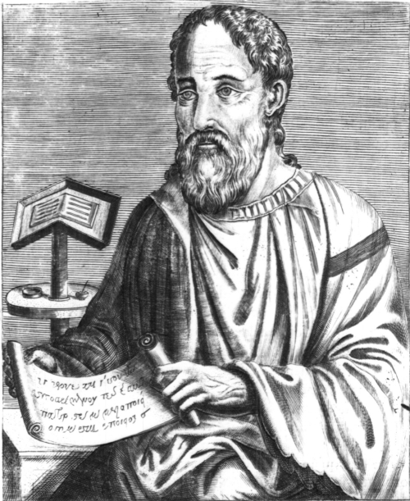
And Back at the Chancery Offices….
Eusebius of Caesarea calls a synod in Syria that affirms the correctness of Arius.
Total chaos is not sweeping the Eastern Church
Constantine sends Ossius of Cordova to mediate the situation.
  Constantine doesn’t really care what the conclusion it.
  He simply wants a conclusion.
Everyone ends up at the Capital: Arius, Eusebius of Caesarea (himself recently excommunicated), Eusebius of Nicomedia, Alexander, Ossius, Helena ( a fan of Lucian of Antioch)
Notes:
Eusebius of Caesarea, another supporter of Arius, and another guy who gives Athanasius a hard time later in life, calls a synod in his diocese. Another Diocese is now involved in the Arian issue. Chaos is spreading throughout the entire church.
Constantine, who does not like to use persecution or other means of persuasion, shall we say, sends his advisor Ossius of Cordova to mediate. Constantine really doesn’t care what the conclusion is. He just wants a conclusion. Everyone involved eventually ends up at the capital to present their cases. Then someone has a brilliant idea. We don’t know who it was, but somehow THE idea comes forward.

Slide 19
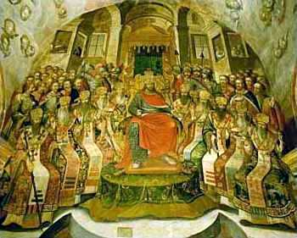
And the Result Was….
The Council of Nicaea in 325.
Athanasius counts 300 bishops. Then number is “increased to 318” because of the biblical significance of the number.
The Council settles on the “homoousious” definition of consubstantiality.
  Constantine hears it is okay in the West, Athanasius is okay with it, and the majority of the Council will accept
  He gets behind this definition
In the end, Arius is condemned.
Notes:
There is going to be an ecumenical council. Every bishop everywhere is invited. They can use the imperial post to get there at the Emperor’s expense. In the end, about 300 bishops show up according to Athanasius count. Later lore expands it to 318, the number of troops Abram uses to free Lot. The Council definitively condemns Arius by adopting the use of the term consubstantial—of one essence—to describe Jesus. Constantine checks to see if it is okay with Athanasius and with the West. He then gets behind it. We use that term to today.

Slide 20
So What Happens?
Arius and a handful of those who voted with him are sent into exile in Illyricum.
This did not end Arianism though.
Arius redrafts a Creed that could be interpreted as Orthodox and makes another run at Constantine.
Constantine appears to have thought about reopening the Council again in order to have Arius reinstated for the sake of peace
Alexander keeps stalling until he dies.
It is now the problem of Athanasius.
Notes:
Arius and a handful of those who do not accept the consubstantial definition are sent into exile. Constantine has been criticized for this approach, but in the end, Arius was treated better than Constantine’s own son and wife. He was as sent to Illyricum in exile.
This is not the end of the story though. Arius continues to agitate even formulating a creed that doesn’t mention consubstantial. Constantine, seeing the issue still hasn’t gone away , rethinks his position, and asks Alexander to take Arius back in. Alexander stalls. He doesn’t want Arius anywhere near his see? Why would he? The major troublemaker in his diocese is in exile, and it is the first chance for real peace.
Alexander keeps stalling until he dies. The election of is successor is a contested one, as groups come out of the woodwork to try and elect someone sympathetic to their cause. It is Alexander’s deacon Athanasius who is elected. He is just as uncompromising as Arius is. And doesn’t allow Arius back into Egypt either.
It is here various groups begin accusing Athanasius of rape, murder, etc. We think our current political tone is rather shocking. It is nothing like the politics of that day.

Slide 21
Athanasius’ Years of Trouble
Constantine begins to waffle when Ossius leaves for Spain as both Eusebius’ gain increased influence.
He wishes Arius to be reinstated.
Arius attempts to return to his parish, but rioting happens in the streets
  Antony comes to support Athanasius.
  The monks support Athanasius
All of this ends when Arius dies in the bathroom
  Apologists make a lot of hay out of this death.
Notes:
When Arius attempts to return to his parish, he is repulsed by an uprising led by monks. Antony of the Desert comes in from the desert to make a stand for Orthodoxy. Arius’ part in the drama is over when he dies in the latrine, a fact that Athanasius and his supporters make a big deal about. This calls to mind the book written by Lactantius on the deaths of the persecutors. Each emperor that persecutes Christians dies a more gruesome death than his predecessor. That is God’s will. Arius suffers the same shame, in that he dies on the toilet.
I have no doubt covered a massive topic very quickly due to time constraints. If you have any questions though, you know where to find me.

