Slide 1

Athanasius the Great
The Meletian Schism
Module 3C
St. Cyril and Methodius Byzantine Catholic Seminary
Byzantine On-Line
Deacon Mark Koscinski CPA D.Litt.
Notes:
Welcome back everyone. In this module, we are going to talk about the Meletians Schism. Or, more correctly, the Meletians schisms. Most works on the life of Athanasius spend a lot of time---as they should—on the Arian schism and the work Athanasius in combatting Arianism.
There was another schism that Athanasius had to deal with though, and I waned to spend a few minutes and focus in depth on the Meletians. We will pick up on the Arians later in the course.

Slide 2
The Meletian Schism
There were actually two Meletian schisms in the 4th century
  Egypt
  Syria
They are NOT the same, but related.
Athanasius had his hand in each of them.
Not as prominent as Ariansim, but nevertheless an obstacle to Athanasius.
Notes:
There were in fact two Meletians schisms in the fourth century. Both of course were started by a person named Meletius, but they definitely were not the same people. The schisms were NOT, I repeat NOT the same, but they were related in many ways.
St. Athanasius had his hand in each of them.

Slide 3

Egypt
Meletius of Lycopolis condemned Christians who hid from authorities.
He demanded to do Liturgies in defiance of the State
  That didn’t end so well for him.
While imprisoned, he founded the “Church of the Martyrs”
  Excluded the “lapsi”
Released in 311 from prison.
Had great moral authority
By 325, he had 28 bishops following him.
Notes:
The Egyptian schism is the one we think of most when we speak about Athanasius. Meletius of Lycopolis, who we saw earlier in this course condemned Christians who hid from the authorities when they came to arrest them. This was what Athanasius did several times, and Athanasius is forced to write to justify his actions.
Meletius calls for the celebration of the Liturgy, even when the persecution is going on. He of course is picked up as a high profile offender, and is shipped away into a brutal exile. While he is away in exile, he founds the Church of the Martyrs. No lapsi—i.e. the lapsed need apply.
Meletius is released from prison in 311 and then begins to build his authority. There is a lot to admire in Meletius. He afterall not only talked the talk, he walked the walk. It is hard to condemn a guy like that. Unless of course, you start your own church. In any event, he has 28 bishops who agree with him by 325. Meletius is rapidly becoming a force to deal with.

Slide 4
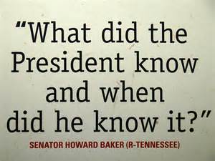
Egypt—Part II
Alexander of Alexandria wanted to reconcile with the Meletians because of the greater Arian threat.
Athanasius would have no part of this when he succeeded as archbishop of Alexandria.
This drove the Meletians into an alliance with the Arians.
They accused Athanasius of:
  Beating Meletian bishops
  Murdering one
  Using a Meletian chalice for secular purposes.
Notes:
Alexander the bishop of Alexandria has a two front war going on. He is fighting the Meletians and Arians. Even though he has a great deal of personal distaste for Meletius, he does try to reconcile with them. He saw Arianism as the much bigger threat.
Athanasius, who is elected in 328, will have to part of this. He doesn’t want Meletius back. This drives the Meletians into what I will call an informal alliance with the Arians. The enemy of my enemy, I suppose.
The Meletians accuse Athansius of murder, mugging and using a Meletian sacred vessel for profane reasons. In short, the politics gets really dirty, really quickly. Athanasius is acquitted of all these charges, but many scholars do think he may have acquiesced. I suppose to paraphrase Howard Baker, What did Athanasius know and when did he know it?

Slide 5

Egypt—Part III
What Happens?
Well, Not Really…..
The Nicene Council attempted to reconcile the Meletians in
However, the acrimony lasted until the 5th century.
There are still traces of them in the 8th century.
Notes:
In the end, the Meletians do not have the same juice as the Donastists in Africa. The Donatists continue for a period of time. The Meletians begin to die out in the 5th century, about 50 years after the lifetime of Athanasius. He never completely sees them going away. Constantine does not choose to persecute them after the Great Council, a decision that I believe to be correct. The Meletians come to be seen as a more geographic and political battle rather than a religious battle. That helps account for their passing. Nevertheless, there are elements of the Meletians still handing around in the 8th century

Slide 6
Syria
Schism originated in Antioch in the 4th century
  Church was split between Arians and the Eustathanians
  Eustathians were the Nicene Christians.
Meletios (another one) was elected archbishop of Antioch
  Deposed by Constantius II
With the support of Athanasius, the orthodox elected Paulinos.
When Julian the Apostate allowed Meletios to return, there were three bishops that claimed the throne of Antioch.
  Julian loved to see chaos amongst the Christian community in his bid to restore paganism.

Slide 7
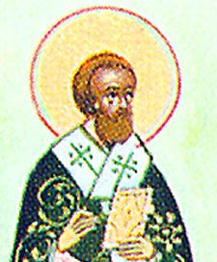
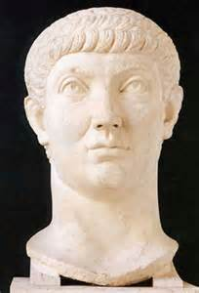
In This Corner…
Meletius of Antioch
Constantius II

Slide 8
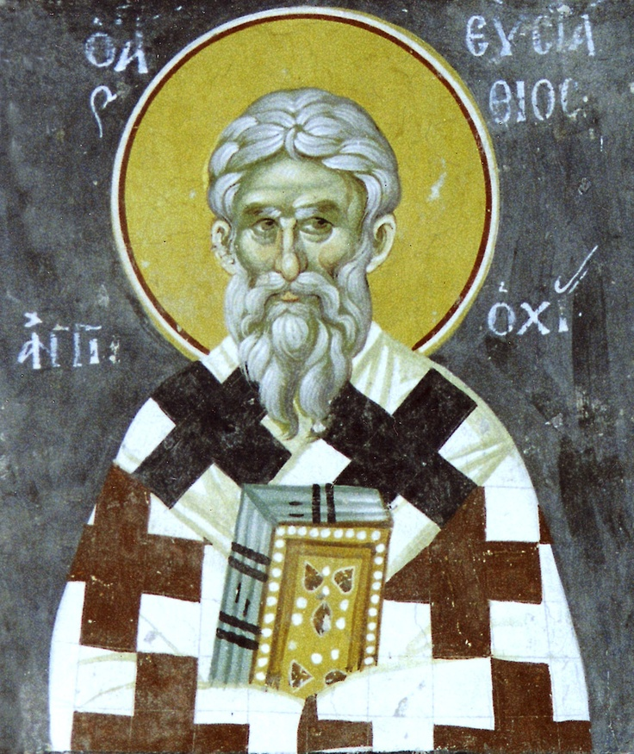
Eustathios of Antioch
Opponent of Ariansim at the Nicene Council
Bishop of Antioch 323-329(?)
Deposed by an Arian synod and exiled.
Little of his writings has survived

Slide 9
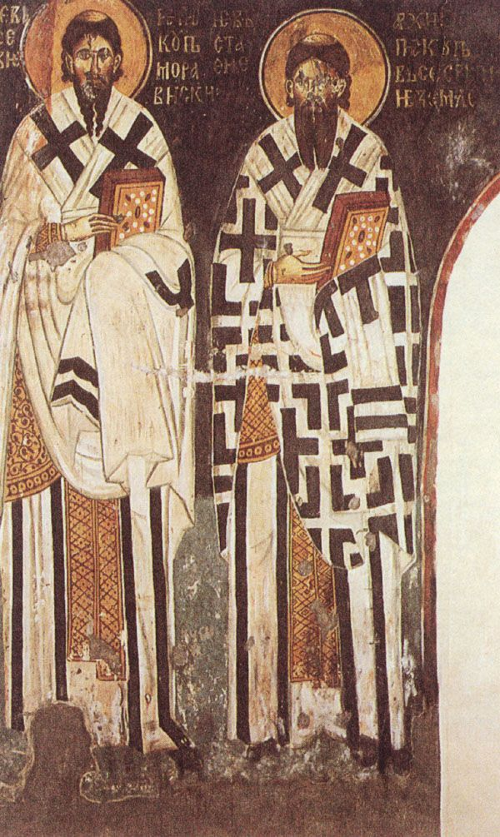
Eustathios of Antioch
Attacked ancient philosophers
Criticized Origen as too allegorical
Criticized the Melchisedekians
  Thought Melchisedek was greater than Christ
Criticized the Arians:
  The Logos assumed the entire man and not only the body (sarx)
  Strongly emphasized the two natures of Christ.

Slide 10
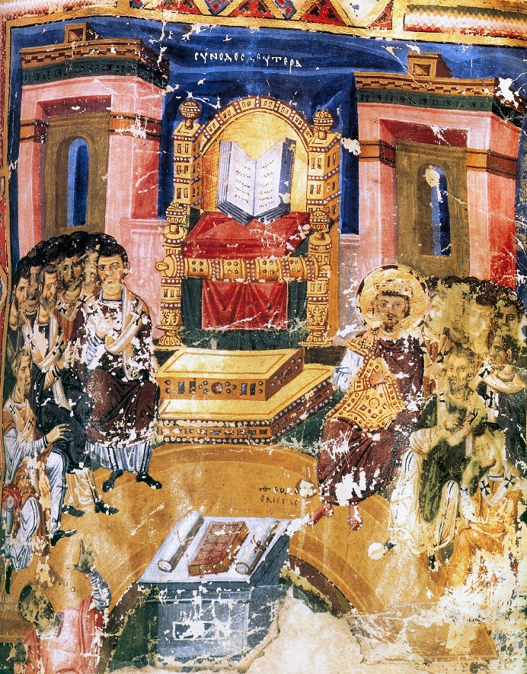
Syria—Part II
The Orthodox split into two camps:
The Meletians believed God was one ousia in three hypostases.
  The Eustathasians regarded this as being Arian
Eustathasians regarded God as
  One ousia and hypostases and three prosopa
  The Meletians regarded this as Sabellianism
Meletios presided over the Council of 381
Reconciliation with the Eustathians was only achieved in 413.

Slide 11
Glossary
Hypostases—individual or real existence. It comes to mean the individual property of each member of the Trinity
Ousia– an individual reality that is shared by each member of the Trinity with the others.
Sabellianism—One God who appears in three different modes.
Ousia and Hypostases were considered the same until the Council of 362, where Athanasius approved the difference between the terms.
Cappadoceans and the Council of 381: God is three hypostases and one ousia.

Slide 12
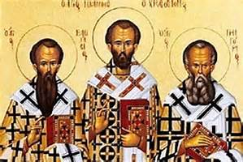
The Cappadocian Fathers
Basil the Great
His younger brother, Gregory of Nyssa
His friend Gregory the Theologian
Notes:
The Cappadocian Fathers are near contemporaries to St. Athanasius, and they make their ideas felt at the second ecumenical council. They are:
Basil the Great, Archbishop of Caesarea in Cappadocia
His brother, Gregory of Nyssa,
And Gregory the Theologian.
Basil and Gregory are two of the Great Greek Doctors of the Church.

Slide 13
Glossary—Part II
Monarchianism—
  Dynamic—Adoptianism
  Modalistic—denies the Logos
  God simply appears as three persons in salvation history
  An attempt to make the Christian God monotheistic.
  Sometimes incorrectly used to designate the source of divinity.
Modalism
  Sabellianism
  Based on Greek theory of epiphanies
Notes:
Monarchianism first needs to be distinguished from the Monarchy of the Father. The latter term is one that I hate cause it could be confused with Monarchianism, a cover term for a series of heresies.
Dynamic Monarchianism is adoptionist---Jesus became the savior at a certain point in time. The focus is on his birth or his baptism usually. God adopted Jesus.
Modalistic Monarchianism is sabellianism—god simply appeared in three different modes at different times. This is an ingenious attempt to keep Jewish monotheism which modalism neatly explains.
Modalism is another term for monarchiansim.

