Slide 1

Athanasius the Great
The Life of Antony—Introduction
Module 5A
St. Cyril and Methodius Byzantine Catholic Seminary
Byzantine On-Line
Notes:
Welcome back everyone. Today we turn our attention to the Life of Antony, probably the most influential book written by St. Athanasius. Our class today will introduce some of the main themes in the Life of Antony. The next module will be a detailed review of the individual chapters of the book.

Slide 2
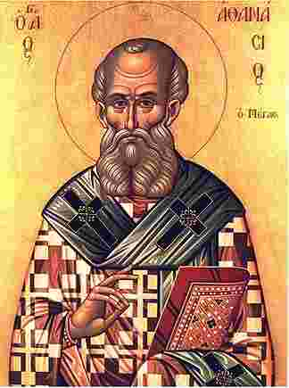
Intro to The Life of Antony
Composed during the third exile of Athanasius (355-362).
It was a posthumous biography.
  Antony died in 356
Literary form:
  Exemplar was the pagan’s lives of their heros.
  Established Christian hagiography.
  Martyrdom of Polycarp established martyrology.
Notes:
The Life of Antony was written during the Third Exile of Athanasius. This was a long exile, lasting over the reigns of Constantius II and Julian the Apostate. I suppose like anyone else in exile, Athanasius can only receive letters and write letters. He is separated from his Archdiocese.
The life of Antony was written shortly after the death of Antony in 356 at the age of 105. Yes, that’s right. 105. Perhaps it was the good clean living, or the desert air, or his holiness that made the difference. Athanasius began receiving requests for information about Antony, so he decided to write the definitive biography.
This book is influential for many reasons, not the least of which is that it set the standard for Christian hagiography to follow. In its own way, it was just an influential as the Martyrdom of Polycarp which set the bar for martyrology, or the story of the death of martyrs.

Slide 3
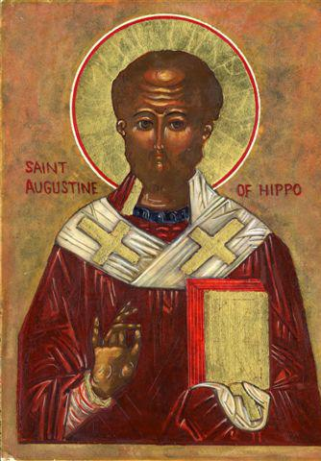
Intro to the Life of Antony
Many wanted to know about the life and discipline of Antony
It was an immediate hit. It enjoyed wide circulation.
While written in Greek, it quickly circulates in Latin
It not only appealed to Christians, but also to others
Reading the biographies of holy men and women was fashionable at that tie in the Roman Empire.
Notes:
The life of Antony was an immediate sensation. It enjoyed wide circulation, not only amongst the Greek speaking world, but the Latin speaking world as well. St. Augustine, a later Great Doctor of the Church was moved by the Life of Antony.
More importantly though, it appealed to pagans as well as Christians. Reading the biographies of holy men and women was fashionable at that time in the Roman Empire. There is of course a whole tradition of biography in the Roman and Greek world. Athanasius uses this form to make it more attractive to potential converts. As we have mentioned, Athanasius was an educated man. He was familiar with classical education.

Slide 4
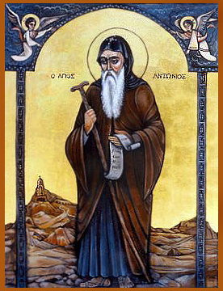
Was Athanasius an Eye-Witness?
NO
Athanasius suggests he was only an eye-witness once.
Antony visits Alexandria in 337/338. There is a “we passage”.
If Athanasius could have more credibly connected himself to Antony, he would have.
Notes:
We come to a very important question. Was Athanasius an eye witness to the events in the Life of Antony. The answer seems to be a resounding NO. Athanasius suggests he was an eye-witness once, when Antony visited Alexandria in 337/338. There is a “we passage”. If Athanasius could have connected himself more with Antony, he would have done so.
Nevertheless, common sense has to prevail here. Athanasius was exiled for a significant part of his life. That surely cut down on the amount of time he could have spent with Antony as well.

Slide 5
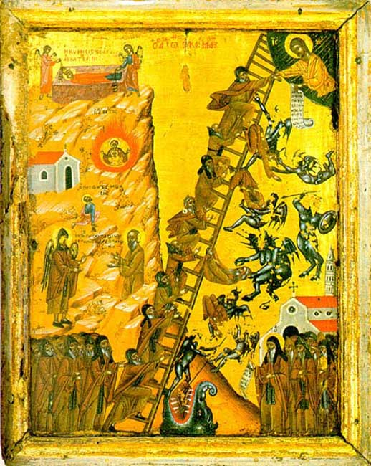
Four Qualities of Antony
Antony is “convertible”
  He was born a Christian, from a Christian family
  He has a “conversion experience”
  He is convertibly to higher levels of spiritual attainment
    Ex. John Climicus
Aspires to Monastic holiness
Salvation is in Christ
  Antony exhausts his own resources in quick order
  He was entirely dependent on God
Notes:
What is it that makes Antony ? One scholar suggested there were four essential qualities.
The first is he is “convertible”. He is open to the impact of God on his life. Antony was born a Christian, and he seems to be an attentive Christian. He has a conversion experience in church. He is convertible to higher levels of spiritual attainment, just in the same way the John Climicus—or John of the ladder advocated for his monks. Antony’s life is a work in progress—he is a pilgrim on earth.
Antony aspires to monastic holiness. He finds a mentor and studies how to become a monk.
Antony exhausts his own resources very quickly, especially in the battle against the demons in the desert. He becomes entirely dependent on God for help. How that is accomplished, we will see in our next module.

Slide 6
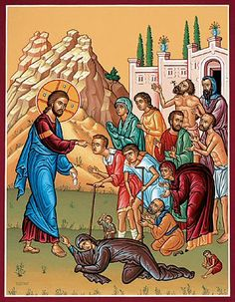
Four Qualities of Antony—Part II
He comes into identity with his savior
  Theosis
  He worked good deeds just as Christ had done.
  Even his body almost became immortal
Notes:
Finally, Antony comes into unity—identity with his Savior. We have an example of theosis at work. Antony becomes a Christ like figure—not Christ—Christ like, and does great deeds just as Christ had done. Antony almost becomes immortal as we will see, dying at the age of 105. think about that. That is an astonishing feat even today, with all the advances in medicine. His age at his death was evidence of his holiness.

Slide 7
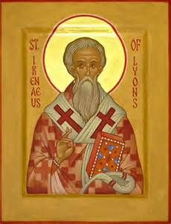
Theosis of Antony
Transmuted into an immutable deified person
Athanasius maintains a sharp distinction between the Logos becoming man and man becoming deified.
  They should never be confused.
Iranaeus: “He became man as we are so that we might become as He is.”
Notes:
Antony is literally transmuted into a deified person. Now, lets make a sharp distinction. Athanasius is very careful to say there is a sharp distinction between the Logos becoming man and man becoming deified. In one case, it is God becoming like us. In the other, it is a man taking on God-Like qualities. It is important these concepts never be confused. We will discuss this topic more in our seventh session.
The concept is though is one expressed earlier by St. Iranaeus of Lyon: QUOTE

Slide 8
Theosis of Antony
He obeyed the Scriptural injunction to sell all and follow the Lord.
He learned from another hermit on how to prepare for this life.
He recited the Scriptures
  He was not an educated person
He prayed hard.
He taught others
Notes:
Yet, Antony had to open himself to the influence of grace.

Slide 9
The Theology of Antony (and Athanasius)
Only God saves.
Arians are despicable because they contended Jesus was only just enough deity to get the job done of saving humanity.
The salvation of the Arians was a salvation brought about by someone or something that had just gotten over the line itself.
Yet, isn’t this the appeal of Arianism?
  It was logical
  It didn’t involve consubstantiality
To Athanasius, it was the vanquishing of death that mattered
Notes:
To Athanasius, only God saves. We have mentioned that as the soteriological imperative. What really irritated Athanasius was the Arians conceived of the Son as someone that had just enough God like qualities to save us. He was not the infinite. He was someone that got over the line himself with enough juice to save us as it were. He then kind of pulls us along.
Yet, isn’t this the appeal of Arianism though? First of all, there are no Trinitarian concerns. We don’t have to have this complex ousia and hypostases. If you applied Occam’s Razor, the simplest theory is usually the correct theory, then Arianism seems to win hands down. And of course, they developed their own Scriptural proof texts for it.
But to Athanasius, it was much more. It was the conquering of death, the Trampling of death that the Resurrection promises to us that was so important. Today, we sing that ad infinite during the Easter. By death you trampled death, by death you trampled death, and to those in the grave, and to those in the graves, he granted, he granted, he granted life. More on all of this in Class Seven though.

Slide 10
A Classic
It told of how Antony disengaged himself from life
It had a great plot:
  Antony’s search for perfection and self-interrogation and his exertions
  Interspersed with Divine Help
It has great biblical themes
  The temptation in the wilderness
  The imitation of Christ
The book is written in such a way that it appeals to potential Christians and converts alike.
Notes:
So, this book has all the makings of a classic. It told how Antony disengaged himself from life, but not in a way that was dishonorable. He cared for his sister. It had a great plot: Antony’s search for perfection with is exertion and his self introspection, interspersed with Divine Help. There are great biblical themes—Like Christ, Antony is tempted in the desert and he imitates Christ. He hears the call to sell everything and follow Jesus. And he does. You can see the appeal this book has to Christian and non-Christian alike.

Slide 11
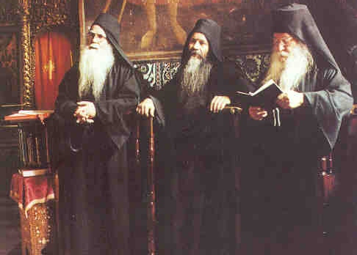
Monasticism
Where the monk’s austerities could not be imitated, they could be admired.
Ordinary people could participate vicariously in Antony’s struggles.
Notes:
Monasticism becomes the archetypical Christian life. Look, even today, we in the Eastern Church follow many monastic prescriptions. Look at the fasting rules during Lent and our Divine Office. Both are designed for the prayerful life. A working person cant do those. However, you could support the monks. You could try to imitate them as best as you could—which is exactly the prescription for those in the Easter Church
STORY ABOUT THE OFFICE. John Chrysostom says even the laity should try to do its best to imitate the monks and get up early to do their office.
You cant keep the fasting requirements of a monk and work a job. But you aspire to it on a ladder of holiness.
This is in part why the Eastern Church gives maximums and says do what you can. It holds up the monastic life as a life to aspire to.

Slide 12
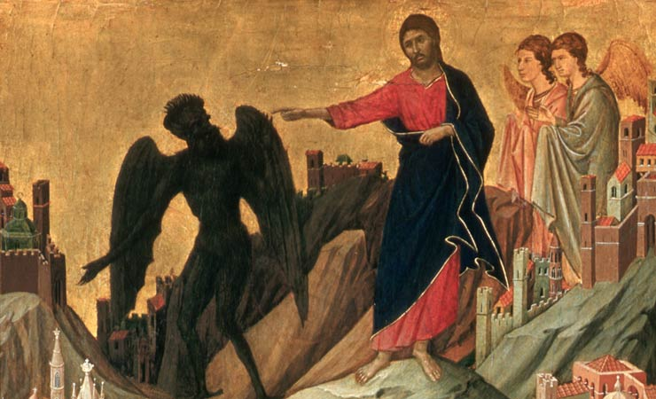
Demonology
A large part of the Life of Antony is devoted to demonology.
The desert is a place of solitude, but it is also a place of warfare.
  Monks are warriors for us
Demons live in the desert
  Temptation of Christ
The monks go to the desert to combat the forces of evil.
Demons can manifest themselves in any form to tempt mortals.
Notes:
When you are discussing the life of Antony, you must always talk about demons. Egyptians had a strong belief in magic and demons. We have already seen how that belief figured into one of the trials of Athanasius. A large part of the book is devoted to demons. The desert is the place where demons live. It is not only a place of solitude, it is where the enemy lives. The monk goes into the desert on our behalf to not only perfect himself, but to do combat with the demons. The monks are warriors and combat the forces of evil.
STORY ABOUT MILLENIUM.
Demons can manifest themselves in many forms, including beautiful women and vicious animals.
Our modern sensibilities are repulsed by the stories of demons. Yet, if you look at them as our inner passions, perhaps the story of Antony is not so repulsive. I am not suggesting demons don’t exist. I am suggesting that even the most skeptical of readers can gain spiritual value from reading this book, as it can be read as an allegory about the conquering oneself.

Slide 13
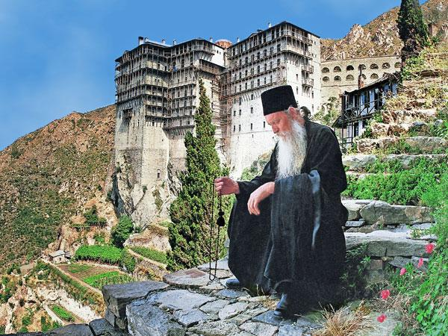
Antony’s Monasticism
Antony was an anchorite.
  Derived from the Greek to withdraw or leave
His distinctive form of monasticism moved the monastic life from the periphery of the city to the desert, to a place of solitude.
But, does he find solitude?
  Constant stream of visitors
  Interpreters are present (ch. 58, 84, 72)
  The Holy Man himself is becoming the place of pilgrimage.
He becomes an arbitrator because of his disinterest and power.
Notes:
Antony was an anchorite, a monk that withdrew from ordinary life. Antony’s distinctive contribution to monasticism was the removal of the monastic from the periphery of the city to the desert, to solitude. We can infer this from the fact that Antony finds a mentor to guide him in monasticism pretty readily.
Does Antony find solitude? No. He has a constant stream of visitors. They bring interpreters. Antony himself is becoming the site of pilgrimages. This tradition has continued today in Eastern tradition. There are pilgrimages to monasteries, where people can gain that extra shot of holiness, go to confession, and sharpen their discipline.
Even more interestingly, Antony becomes a mediator and arbitrator. His holiness makes him the perfect candidate for mediation. Eventually, monastics become the advisors to emperors.

Slide 14
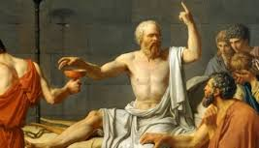
Antony and Philosophy
Antony is not particularly well educated.
He is armed with Christian knowledge and his own reasoning
Christianity is not about being elitist
  No social pedigree
  No privileged training to join
  Monasticism opened the door to the laity and those who never enjoyed elevated status.

Slide 15
Antony and Arianism
Antony is squarely an orthodox Christian.
He aligns himself squarely with the orthodox side in the Arian debate.
He condemns Arianism at least three times (Ch 68-70, 89, 91)
How much of this is Athanasius, and how much of this is Antony?
  We will never know
However, the whole story is Anti-Arian
  Antony’s advance in holiness was due to the power of God
  The Begotten Son of God extended help to those who would become the adopted sons and daughters of God.

Slide 16
Acknowledgment
This class was based on the translation and introduction by Robert C. Gregg and the Preface by William A. Clebsch to the following:
Athananasius: The Life of Antony and Marcellinus. New York: Paulist Press, 1980
I am vastly indebted to their insight to St. Athanasius.

