Slide 1

Athanasius the Great
Theosis
Module 7A
St. Mary’s Byzantine Catholic Church
Adult Education Series
Rev. Deacon Mark Koscinski CPA D.Litt.

Slide 2
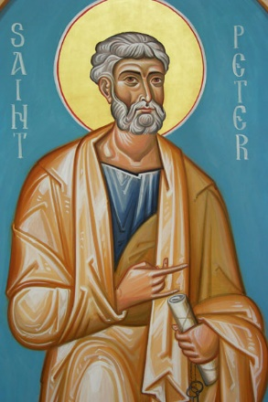
Theosis
Deification (theosis) is the process by which a Christian becomes more like God
2 Peter 1:3-4: …You may be partakers of the Divine Nature.

Slide 3
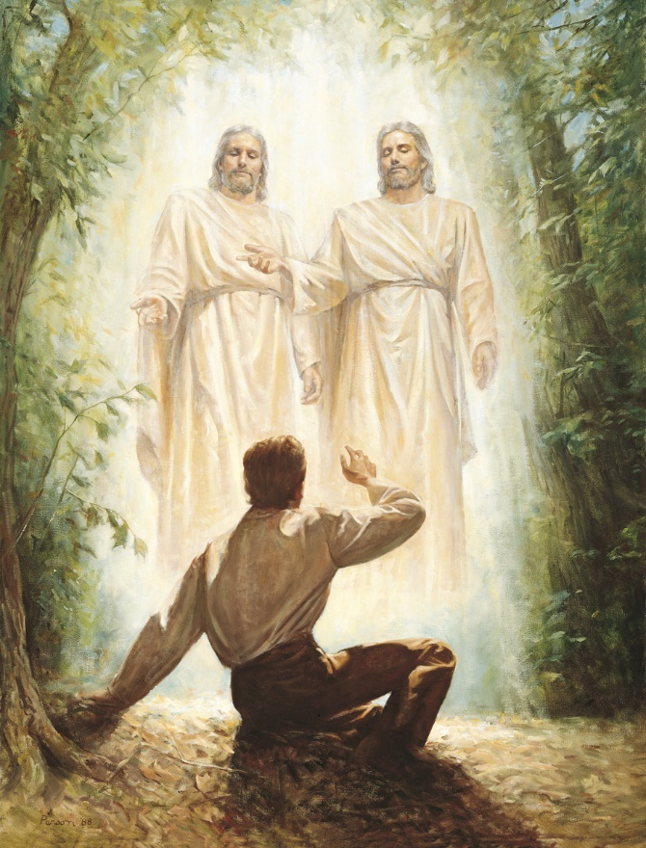
Theosis
Deification does not mean human beings become divine.
We do not become a God.
The Mormon Church has tried to explain their theology as part of deification.
This is a heresy to the Eastern Church.
We are human and not God.

Slide 4
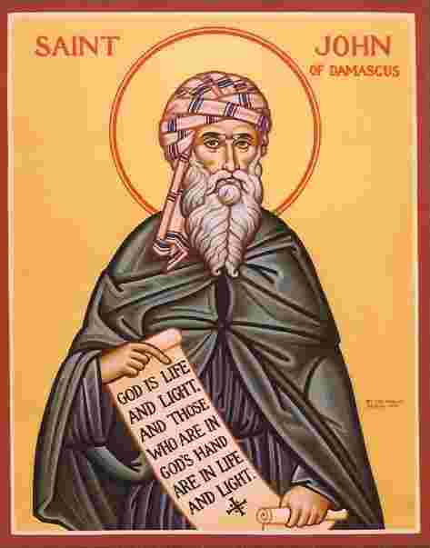
John of Damascus
God in the Scriptures does not refer to the divine nature or essence since that is unknowable
God refers to the Divine energies-the power of God and grace in the world.
The Greek word for god theos—run, see, or burn—are energy words

Slide 5
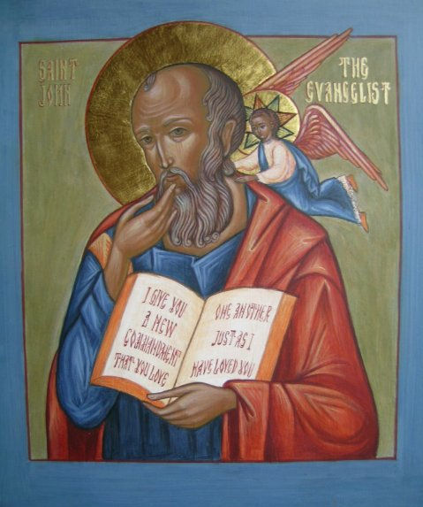
John 10:34
Repeating Psalm 82:6, Jesus says: You are Gods
While He is speaking to religious leaders, the meaning becomes doubly clear.
We are gods that bear the image and the likeness of God

Slide 6
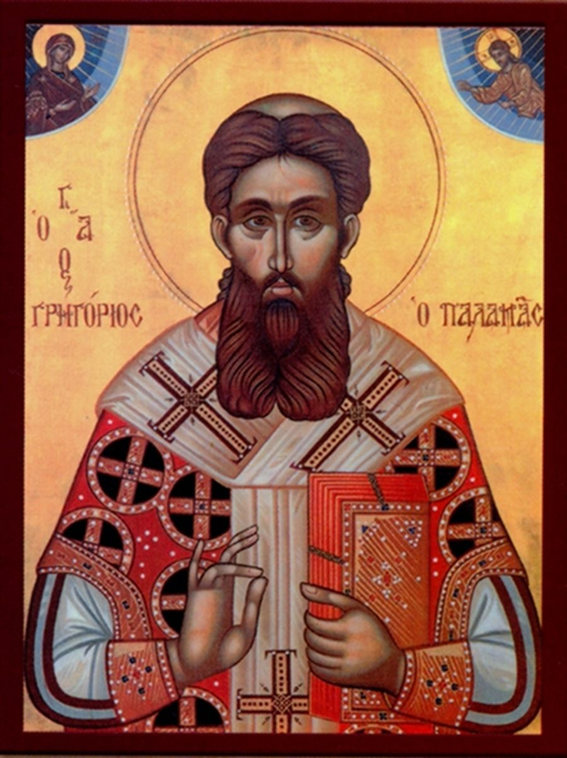
What Deification Is
Theosis is the process of becoming more like God through His Grace or energies.
The Divine image is in all of us
Through sin the image and likeness of God are marred.

Slide 7
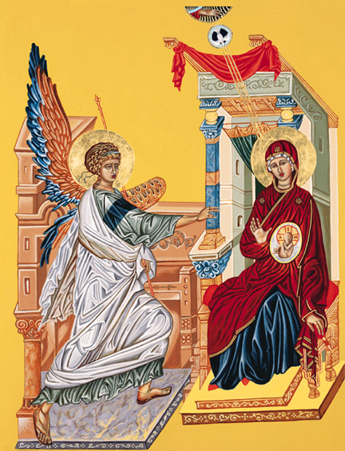
The Incarnation
Through the Incarnation, the Logos assumed our humanity.
This is a re-creation process.
We can be recreated in the image an likeness of God.
Since the fullness of God joined human flesh, it is possible to reach our full potential and our salvation.

Slide 8
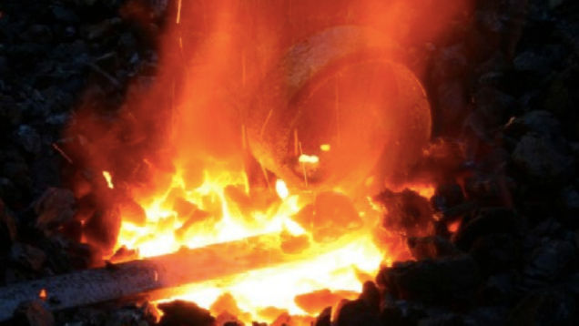
An Analogy
Theosis was demonstrated by the sword and the fire.
A sword plunged into the fire does not turn into fire.
Yet it becomes hot and it glows from the energy of the fire.
This is us when we turn to our Savior.

Slide 9
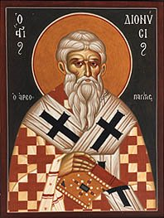
Writings on Theosis
To Become like God insofar as that is possible for man—Plato
Theosis consists of being as much as possible like and in union with God—Dionysius the Areopagite
Exaltation of nature, not its destruction or alteration—Anastasios of Sinai
Participation through grace in that which surrounds the nature of God—John of Damascus

Slide 10
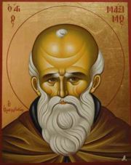
Writings on the Incarnation
Maximos the Confessor:
  Its highest realization is in the deification of Christ’s human nature
  Nature in this context is understood as the essence of man established in the creation, darkened by Adam’s sin.
  In the East, man’s nature is corroded. In the West, it is damaged.

Slide 11
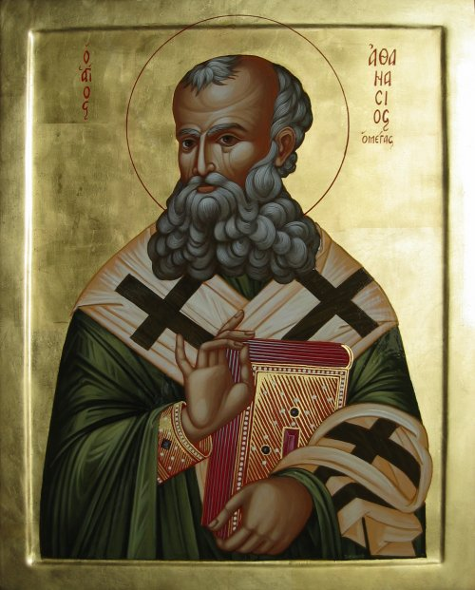
Athanasius on Deification
Athanasius began the original development of this doctrine
“Deification of man through the incarnation of God”
“He became man that we might become divine.
Homoousios of the First Council by itself ensures this participation in deification.

Slide 12
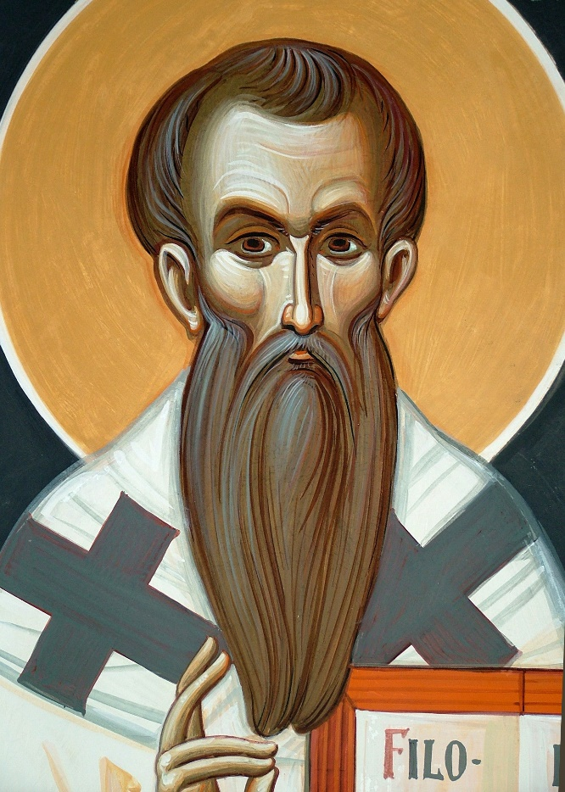
Basil the Great on Deification
Opponent of the Pneumatomachoi
Deification of man as sanctification is rooted in the work of the Holy Spirit
Without the Holy Spirit, man would neither be deified or sanctified.

Slide 13
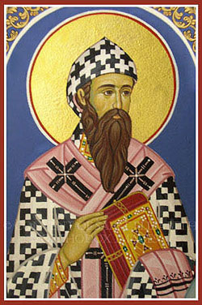
Cyril of Alexandria
The deification of man is determined by the indwelling of the Trinity.

Slide 14
Partial Summary of Athanasius’ Teaching on the Incarnation
What is not assumed is not healed—John of Damascus
The Two Natures of Jesus are United.
There are two operations in Christ
Christ is to be adored as a true man.
Christ had a capacity to suffer
If Adam did not sin, then the incarnation was not necessary.
However, in certain senses, the Incarnation was necessary.
Christ wished to redeem man from sin and servitude to the devil.
Christ wished to cure the sin of Adam.

Slide 15
De Incarnatione
God in his goodness makes them [his creation] share in his image, our Lord Jesus Christ, and fashions them after his own image and likeness. In this way, graced with a knowledge of the image, through that image they might have a knowledge of the Father and in a knowledge of their creator might lead to a happy and blessed life.
And having brought back human beings from corruption, he returned them incorrupt once again and called them back from death to life by the body that he had taken to himself and by the grace of the resurrection—making death disappear from them like straw before the fire.

Slide 16
De Incarnatione
There was a certain inevitability of the Incarnation after the first sin.
God’s plan would have been destroyed if he permitted the dissolution of His creation, humanity, even though this was just punishment.
This would make the Creator seem powerless in the face of sin.
God had to be consistent with His own justice though.
Only the Word, who had brought mankind out of nothingness could call it back from death and annihilation.
The Word, by taking on mortal flesh, could suffer on behalf of His Creation to fulfill the divine law requiring punishment

Slide 17
De Incarnatione
Being Word of the Father, and over all things, it followed that he alone was able to recreate everything, to suffer on behalf of all and to intercede for all with the Father.
It was thus that he bore the curse for our sake…with his arms stretched out…thrust aloft into the atmosphere, he purified the air of the demons that made that element their inhabitation.
Christ is the teacher who reveals the Father, offering to mankind the knowledge without which it cant be saved.

Slide 18
De Incarnatione
After our Savior’s Resurrection, however, death is no longer a reason to fear; those who believe in Christ tread upon death as if were nothing….for death does not mean destruction, but life....Once they have been converted to the faith and teachings of Christ, by contrast, they consider death to be such a small thing that they rush upon it with enthusiasm and make themselves witnesses to the Resurrection that the Savior has accomplished against death.

