Slide 1

Athanasius the Great
What Happens to the Arians?
Module 7B
St. Cyril and Methodius Byzantine Catholic Seminary
Byzantine On-Line
Rev. Deacon Mark Koscinski CPA D.Litt.

Slide 2
What Happens to the Arians?
Compelling Argument
However…..
No need to have the Trinity to explain the Godhead.
Arianism was a form of subordinationism.
It preserved the monarchy of the Father and a strict monotheism
Raised problems with salvation since the sacrifice of Christ, who was less than fully God might not be sufficient.
It could prevent genuine theosis.

Slide 3
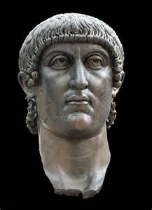
After the Nicene Council
The Council and Emperor…
Constantine the Great
Arianism was condemned by the First Council.
Hosius, the advisor to Constantine leaves for Spain
Constantine begins to waver
Exiled Arians are recalled in 328
Eventually, Athanasius and other orthodox bishops get banished.

Slide 4
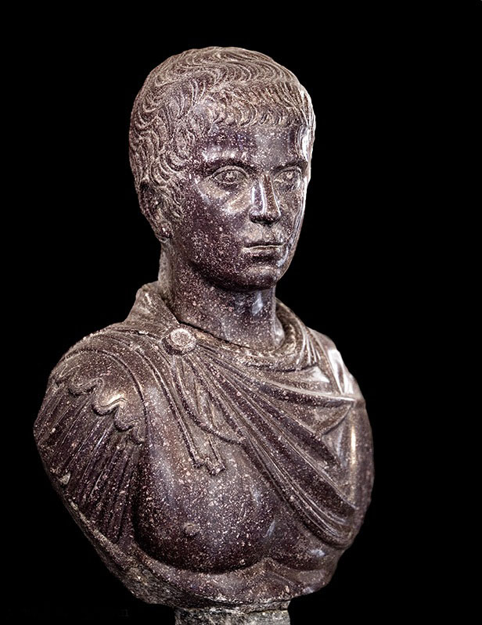
Constantius II
After Constantine
Constantius II
Constantius openly supported the Arians.
Several local councils attempted to heal the rift through various compromises.
None were completely successful

Slide 5
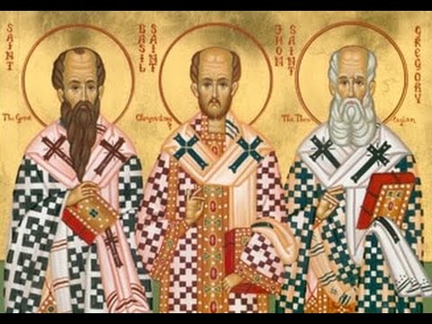
Types of Arians
Fracture
Cappadocian Fathers
Arianism begins to split itself:
  Homoiousians
  Pneumatomchoi
  Anonmoians
  Homoians

Slide 6
Homoiousians
Just an iota of difference
Often called Semi-Arians
Did not accept the term Homoousios but believed in the divinity of Christ.
This idea goes back to Origen, but this group came into existence ca. 356 in an attempt to find a compromise.
The philosophical problem is what does it mean to be “like” God?
Likeness also means differences
  Polytheistic
  Arian
Homoians—strict Arians

Slide 7
Pneumatomachoi
Denied the divinity of the Holy Spirit
The Holy Spirit was a created being, a gift of God, rather than God itself.
From 362, Athanasius sought to exclude the Pneumatomachoi from the Church
Also later called Macedonians
Condemned at the Council of Constantinople in 381.
They survived until the 5th century when their churches were closed.

Slide 8
Subsequent History
The Arian question becomes a rivalry between the churches of Alexandria and Constantinople
Arianism becomes an urban phenomena in the East
Supported by Arian monks.
After the Death of Constantius II, orthodoxy becomes ascendant in the West.
The Eastern Emperor Valens was still an Arian.
The final triumph of orthodoxy came at the Council of 381.
Arianism slowly disappears from the East.
In the West, it is still an issue as the barbarians are Arian.

Slide 9
Later Myth
The Arians burned portraits of the 4th century archbishops of Constantinople and the Virgin
Burned Orthodox Churches
This module drew heavily from The Oxford Dictionary of Byzantium: New York, 1991. Articles: Arianism, Homoiousians, and Pneumatomachoi.
I am indebted to the wonderful scholarship included in this dictionary.

