Slide 1

Athanasius The Great
The Era of Athanasius
Module 1B
St. Cyril and Methodius Byzanitne Catholic Seminary
Byzantine On-Line
Rev. Deacon Mark Koscinski CPA D.Litt.
Notes:
Welcome back to our course on Athanasius. My name is Deacon Mark Koscinski.
In our last module we covered some of the course mechanics, and how the modern church regards St. Athanasius. Today, we are going to look at the era of St. Athanasisus, who lived largely in the first three quarters of the fourth century.
In our next module, we will undertake a short biography of St. Athanasius. However to put any person—any biography into perspective---we have to understand the world that person lived in. There were two key facts (trends) that dominated the life of Athanasius.
The first was the Christianization of the Roman Empire during his life time. The second was the importance of the see of Alexandria and of Egypt in particular to the Roman Empire

Slide 2
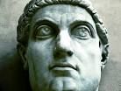
The Giant of the Fourth Century-Constantine the Great
305: Britain and Gaul
309: Spain
312: Italy and Africa
314: Eastern Europe
324: Turkey, the Orient, and Egypt
He reigned until 337.
His shadow towers over this century
Notes:
The Giant whose shadow covered all of the fourth century was that of Constantine the Great. He lived in the first third of the century, but he started the Christianization of the Empire, and the end of persecution. We saw in the last module how Christian thinking begins to flower when the persecution is lifted, and how the great thinkers of the church, unfettered by fear, begin to espouse Christian doctrine. The Empire rapidly adopts Christianity in lieu of the old religions.
Constantine takes control over the Empire slowly, over the course of about twenty yuears. Everywhere he goes, the persecution stops. He makes large gifts to the Church in Rome. He doesn’t make Christianity the state religion , but the writing is on the wall.

Slide 3
The Roman Empire Organization
The Empire is divided into fourteen or fifteen dioceses, all ruled by a vicar.
The diocese consists of up to ten provinces.
Several dioceses are eventually ruled into four praetorian prefectures.
The Church begins to model itself along these lines as well.
Generally, one main church diocese as opposed to the civil diocese becomes the lead church in that area.
Egypt has a predominate place in this structure.
Notes:
Lets look at how the Empire is divided. At various points in the fourth century, the Empire could be ruled by anywhere from one to four Emperors. The Empire is divided into slightly more than one hundred provinces. These are aggregated into dioceses, and the the dioceses are aggregated into the prefectures.
The church begins to use this nomenclature, but in reverse, and organizes itself the same way. In each diocese, one particular see becomes predominant. In the case of Egypt that is Alexandria. In the diocese of Africa, that is Carthage. In Italy, it is of course Rome. In Turkey, it is Nicomedia the imperial capital and Caesarea in Cappadocia.
It is important to realize how important Egypt was to the Roman Empire.

Slide 4
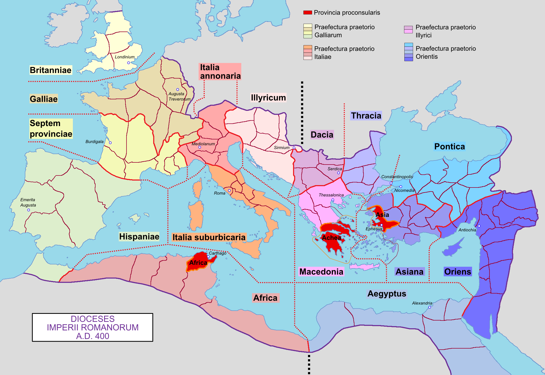
Map of the Roman Empire
Notes:
Here we have a map of the dioceses and prefectures of the Empire. Note the size of Egypt. It is not the Egypt we think of today.

Slide 5
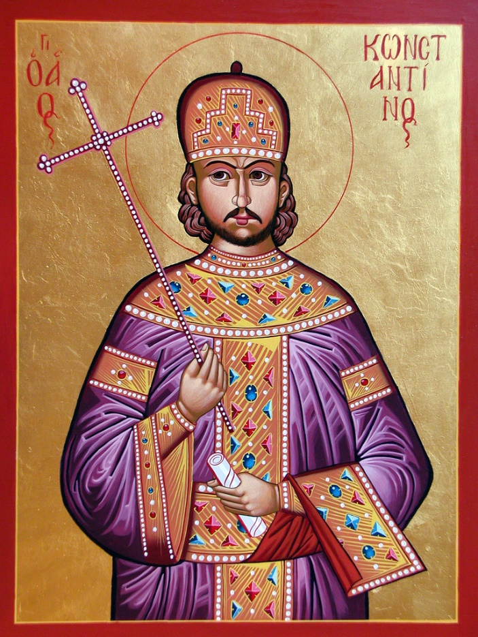
Religious Problems
Constantine ends persecution in the Empire over a period of two decades.
But, problems long suppressed in the Church end up breaking out into the open
Donatism in Africa
Meletianism and Arianism in Egypt
Constantine thought of Christianity as a unifier of the Empire and not a divider.
Notes:
As Constantine marches to the East over two decades, he end persecution in the Church, State persecution that is. While the Church had the boot of the Empire on its neck, things were relatively peaceful. When Rome took its boot off the neck of Christianity, long suppressed arguments begin to break out.
The Donatists incite the diocese of Africa. The Meletians and the Arians incite the diocese of Egypt. This does not fit in with the image Constantine had for Christianity, He saw religion much in the same way those before him did. Religion should be a unifier, and not a divider.

Slide 6
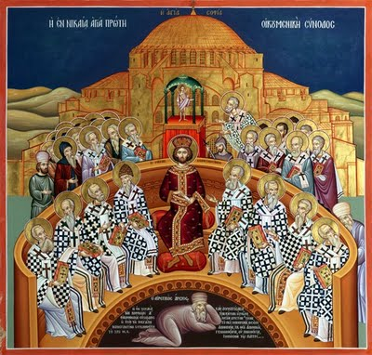
How Does He Deal With this Problem?
Not very well.
Mediation, coercion, and councls all fail.
The most noteworthy of the Councils is the First Ecumenical Council of 325, dealing with the Easter Controversy, Meletianism, and Ariansim.
Notes:
How does he deal with these problems? Not very well I am afraid. Donatism, Meletianism, and Ariansims are around for a long time to stay even after Constantine attempts to bring peace to the various factions.
Cosntantine really doesn’t care about a lot of these arguments. He was a soldier by trade, and not a theologian. He just wants these guys to agree on something. He doesn’t care what it is so the strife will end. Constantien seems to waffle over the thirty years he is in power, often depending on who his advisor was. When Ossius of Cordova was in his court, Cosntantine was a throughgoing orthodox Christian. When Ossius leaves, and he falls under the spell of Edusebius of Caesarea and Eusebius of Nicomedia, he begins to bend to the Arian position. It would go back and forth like this over his entire life.
Constanine liked to use councils of bishops to decide contentious matters. The First Ecumenical Council of Nicaea was just such an attempt. Unfortunately, that didn’t work particularly well either, as these heresies continued well, for the next thousand years.

Slide 7
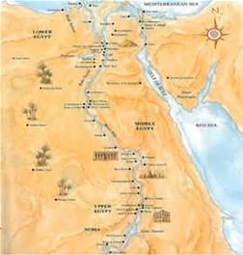
The Prominence of Egypt
Egypt was the wealthiest of the dioceses, with a per capita income exceeding four times some of the other dioceses.
As a result , it was always held very close to the vest by the Emperors.
Notes:
Egypt was the wealthiest of the dioceses, with a per capita income greater than three or four times many of the other dioceses. Accordingly, it becomes the breadbasket of the Empire. Egypt is held near and dear to the heart of the Emperors.

Slide 8
The Geography of Egypt
The fertile Nile made Egypt the economic powerhouse of Europe.
It provided grain to Italy and the urban centers.
Opponents say Athanasius threatens to cut off grain shipments, so this gets the Emperors attention.
This is tantamount to fomenting a rebellion.
The desert had not yet encroached on North Africa as it has today.
Nevertheless, the desert was a significant feature of the geography of Egypt.
The desert becomes the home for thousands of monastics, including St. Antony.
Athanasius is his biographer
Notes:
As we saw in the previous slide, the Nile made Egypt the economic powerhouse of the Empire. You can guage its importance by the number of settlements that dotted its landscape. Grain is regularly shipped in huge grain barges to the urban centers of the Empire. The last thing the Emperor wants is to hear that grain shipments are being held up to Rome and Cosntantinople. Athanasius is accused of planning to cut off grains shipments. This gets the Emperor’s attention, and Athanasius is shipped into exile in Trier. Who can take the chance?
Egypt had one other feature that was to make it prominent in Christian history: the desert. The desert had not yet encroached on the north of Africa as it has today, but it was still a significant feature. The desert was where monks resided. This is where St. Antony lives. Indeed thousand of people follow him to the point one of his contemporaries, St. Pachomius, is said to have over seven thousand followers. Athanasius was the biographer of Antony, still one fo the most famous biographies every written.

Slide 9
The Prominence of Alexandria
Culturally
Religiously
Alexandria may have been the biggest city in the Empire
It was a competitor of the city of Rome
Julius Caesar and Marc Antony paid the price for being too closely aligned with Egypt and Alexandria.
Octavian (Augustus Caesar) owned Egypt personally
Church was started by St. Mark, the secretary to St. Peter.
It was considered to have Apostolic
It was the see of the Archbishop
Cosmopolitan and erudite interpretation of the Scriptures.
Combined with the forceful nature and intellect of Athanasius, it was a religious powerhouse.
Notes:
Alexandria is the most prominent city of the diocese. It was founded by Alexander the Great, and is a cultural and intellectual center. Origen, the famous Church Father, was Alexandrian. It was huge. Alexandria was a direct competitor to Rome for being the number one. city of the Empire. Roman citizens did not take it lightly when their rulers seemed to be moving power to Egypt. Julius Caesar and Marc Antony found out the hard way.
Alexandria had a great religious pedigree was well. Christianity there is ascribed to St. Mark, the personal secretary of St.Peter. It has a tremendous intellectual tradition attached to it, including a sophisticated way to interpret Scriptures. It was considered to be of Apostolic foundation and was the see of the archbishop.
When you compound all of the features of Egypt and Alexandria, and through in the personal intelligence and tenacity of Athanaisus, you have a powerhouse of Christianity. By definition, its leader also becomes a powerhouse as well.
We will hold it for here today. Our next module will cover the Life of Athanasius. I will see you in the chat room this week.

