Slide 1
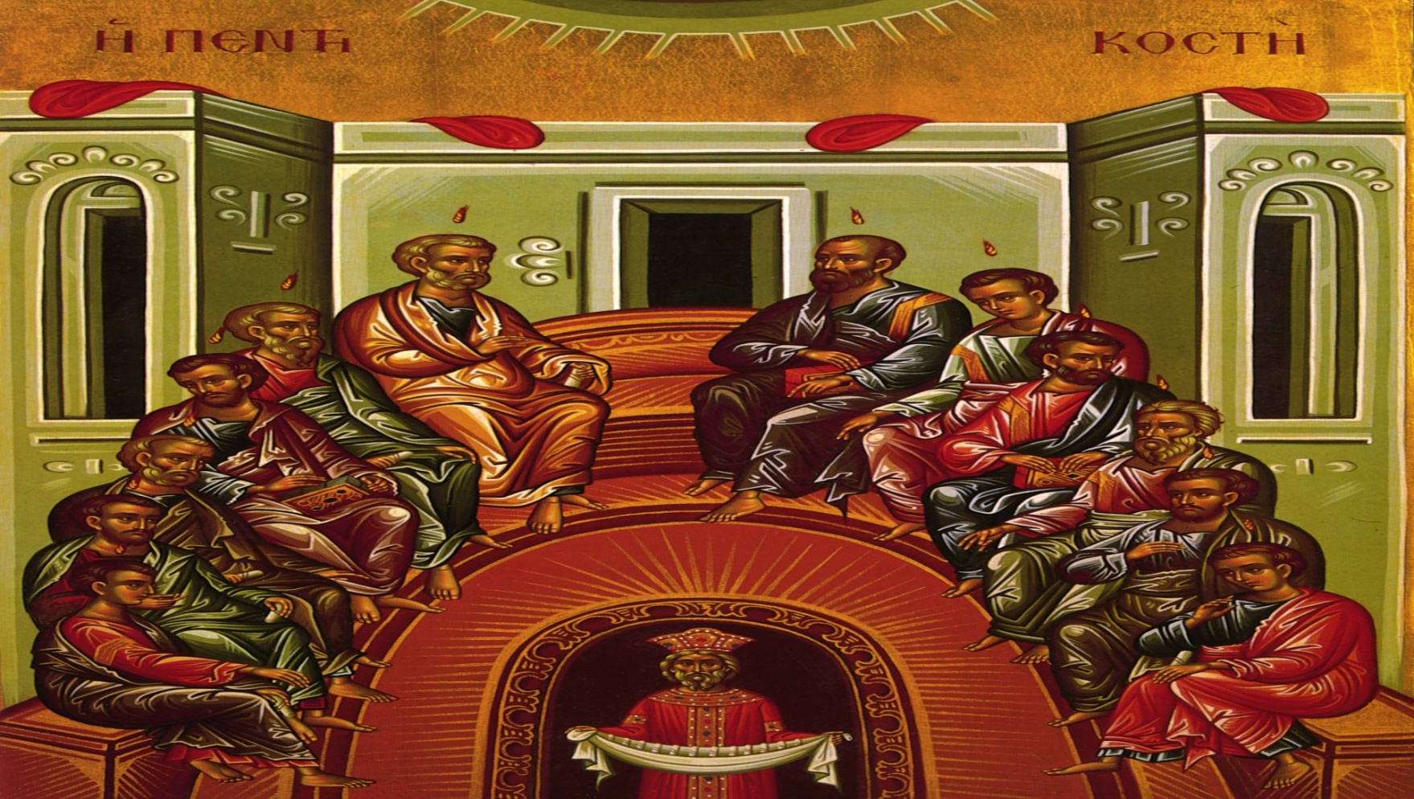
Living the Byzantine Faith
Notes:
We start today with the icon of Descent of the Holy Spirit. We ask for the help of the Holy Spirit to enlighten and deepen our Faith.

Slide 2
Class Mechanics–Introduction
Welcome to our four-session class on the Year of Faith.
Each class will last forty-five minutes and will start promptly at the scheduled time.
Please take a workbook.
Try to do the homework before each class. It will help your understanding, and it will make the class run much smoother.
Notes:
The workbook has the scheduled readings for next week as well as some additional information you might find interesting on these particular topics. Please try to do your readings. It will make the course so much more valuable to you.

Slide 3
Class Mechanics–Classes
Each class will be independent of all the others.
If you miss one, no problem!
Please feel free to take notes but the PowerPoint slides can be emailed at the end of the class upon request.
We invite questions during the class, but please understand that our time is limited.
Notes:
The Four classes are jammed with information. Consequently, we can deal with some simple questions during the course. Please do not feel upset if we don’t deal with your question right away, but we will try to cover all of the promised material. I will be available after class to continue the discussion, or can continue the discussion via email. Please bring a friend to the next class.

Slide 4
Class Mechanics—Your Bible
Try to bring your Bible to the Class.
We will refer to it often.
It does not matter which version of the Bible that you use, but sometimes the translation will be different. For our purposes, one is not better than another.
Getting to be friends with your Bible in the Year of Faith is a good thing!
Notes:
Your work book has some suggestions for picking out a Bible if you don’t have one available.

Slide 5
Course Content
The content of this presentation is not the official position of the Eparchy of Passaic
It is solely for the enjoyment and spiritual enhancement of those participating in this course.
Notes:
This book was chosen as Father Pacwa is a biritual priest who can celebrate both the Roman and Maronite Divine Liturgies. The Maronites are another Eastern Catholic Church that evolved in the Syrian, rather than the Byzantine Tradition. It is an excellent resource if you wish to pursue these topics more in depth.

Slide 6
Course Objectives
To gain a deeper appreciation of our Faith by using the tools the Eastern Church provides for us:
  Icons
  The Church Fathers
  Our Prayers and Services
This works for all Catholics, not just Byzantine Catholics.
Notes:
The Fathers of the Church were the great thinkers and expounders of the Faith. They wrote shortly after the time of the Apostles, and continued until the time of St. John Damascene in about the 800s. The Eastern Church accords them great honor, and strives to worship in the spirit of the Church Fathers. The veneration of the Fathers is a mark of the Eastern Church.
Our Prayers and Services are a great source of understanding for our Faith. These prayers articulate the tenets of our Faith, and we should strive to understand what the prayers are saying to us.

Slide 7
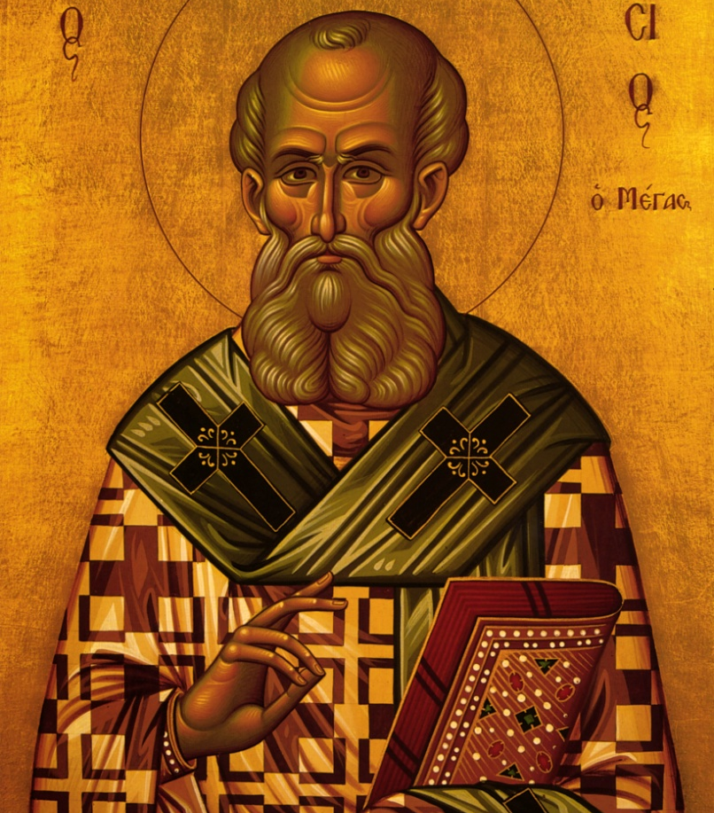
Our Topics
Faith in the Trinity
  Week one
Faith in Jesus
  Week Two
Faith and Conversion
  Week Three
Faith and Daily Life
  Week Four
Notes:
We will use icons in our discussion. This is an icon of St. Athanasius, one of the eight doctors of the Universal Church. There are Four Latin Doctors and Four Greek Doctors. St. Athanaisus was the first to list the canon of the books of the New Testament, and he was a staunch foe of the Arians. The Arians did not believe in the Trinity, and they regarded Jesus as another created being, and therefore, not God.
The Trinity is the Central Mystery of our Faith, so we will devote the rest of this class to it. The Two Natures of Jesus is another great mystery of our faith. We will devote class 2 to our Faith in Jesus. Class Three will cover some of the more famous conversion stories in the Bible. Conversion is simply a manifestation of Faith. In class 4, we will cover topics which are relevant to our daily lives. For instance, Do good works matter? Why do we pray? Why do we worship?

Slide 8
St. Athanasius
Commemorated on May 2 and his return from exile on January 18.
Born in 295 and was highly educated.
Disciple of Anthony the Great, the first great monastic.
Became bishop of Alexandria in 328
An opponent of Arianism and champion of the Trinity.
Exiled several time, totaling seventeen years, six months and twenty days.
Reigned as bishop for forty five years. Died in 373.
Developed the Canon of the Bible.
Notes:
Athanasius was a tireless champion of the two natures of Jesus and the Trinity. This is exemplified by the fact he spent over one-third of his episcopacy in exile. Despite the story of Dan Brown, and the belief by some Christians that the books of the Bible sprang right from the mouth of Jesus, it was St. Athanasius that came up with the first list that contained the Catholic list of books in the Bible.

Slide 9
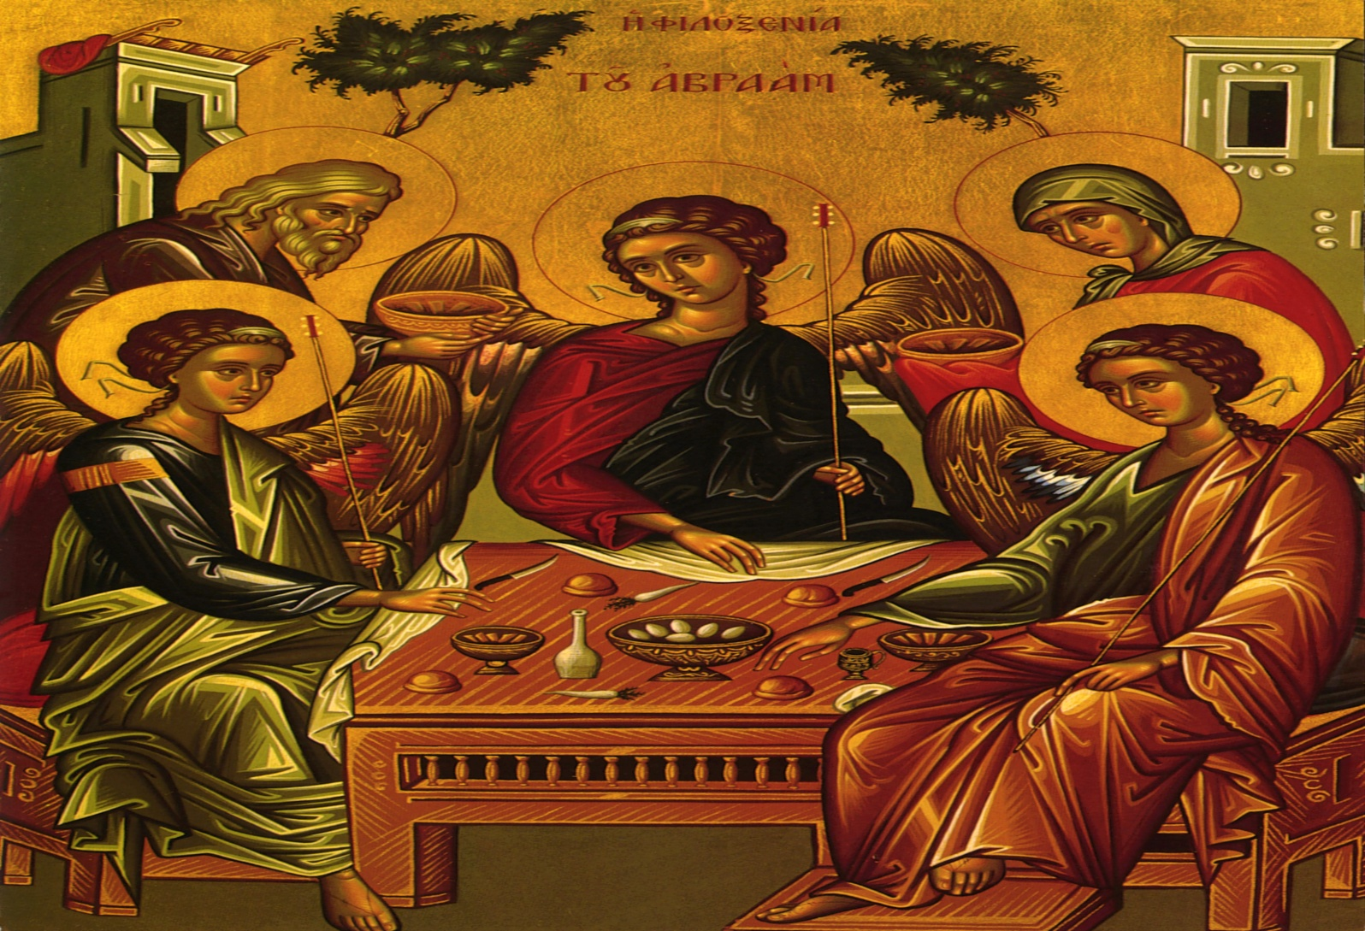
Class One—Faith in the Trinity
Notes:
This is the Icon of the Trinity. It is perhaps one of the clearest explanations of the Mystery of the Trinity you will ever encounter. I once showed a group of children this icon, and asked them what it was. They said the Trinity. What else could three angels represent. This of course, is the visitation of the Three Angels to Abraham as recounted in the Book of Genesis. If you follow the lines of their eyes, they form a complete circuit. Theologians have said the Three persons of the Trinity eternally contemplate their existence, and their relationship. The true Christian life is a participation in the Trinity. We will come across this icon again.

Slide 10
Class 1-Opening Prayer
Heavenly King, Comforter, Spirit of Truth, everywhere present and filling all things, Treasury of Blessing, and Giver of Life, come and dwell within us, cleanse us of all stain, and save our souls O Gracious One!
Glory to Jesus Christ!
Notes:
We open our session today with two of the most common prayers in the Byzantine Church. The “Heavenly King” is a petition for the Blessing of the Holy Spirit, one of the Three Persons of the Holy Trinity. Our most common greeting, “Glory to Jesus Christ” affirms our Praise of the Second Person of the Holy Trinity. As we will discuss today, the Byzantine Faith is indeed “radically Trinitarian”. This sets us apart from the other two Abrahamic religions, Judaism and Islam, where God is One.

Slide 11
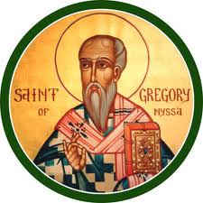
The Trinity Doesn’t Sound So Controversial… Now.
It was Huge Discussion Item!
St. Gregory of Nyssa
Everywhere, in the public squares, at crossroads, on the streets and lanes, people would stop you and discourse at random about the Trinity. If you asked something of a moneychanger, he would begin discussing the question of the Begotten and the Unbegotten. If you questioned a baker about the price of bread, he would answer that the Father is greater and the Son is subordinate to Him. If you went to take a bath, the Anomoean bath attendant would tell you that in his opinion the Son simply comes from nothing.
Brother of St. Basil the Great
Notes:
We hear about the Trinity all the time, and we accept it as a given. But it was not always the case. In fact, this was a hotly disputed item in Church history. Lets take a look at one of the Cappadocian Fathers---St. Gregory of Nyssa, the brother of St. Basil the Great, and St. Macrina.
It is in fact the Trinity that is one of the Central tenets of our belief. So, lets take a look at some famous attempts to explain it, from the Church Fathers.

Slide 12
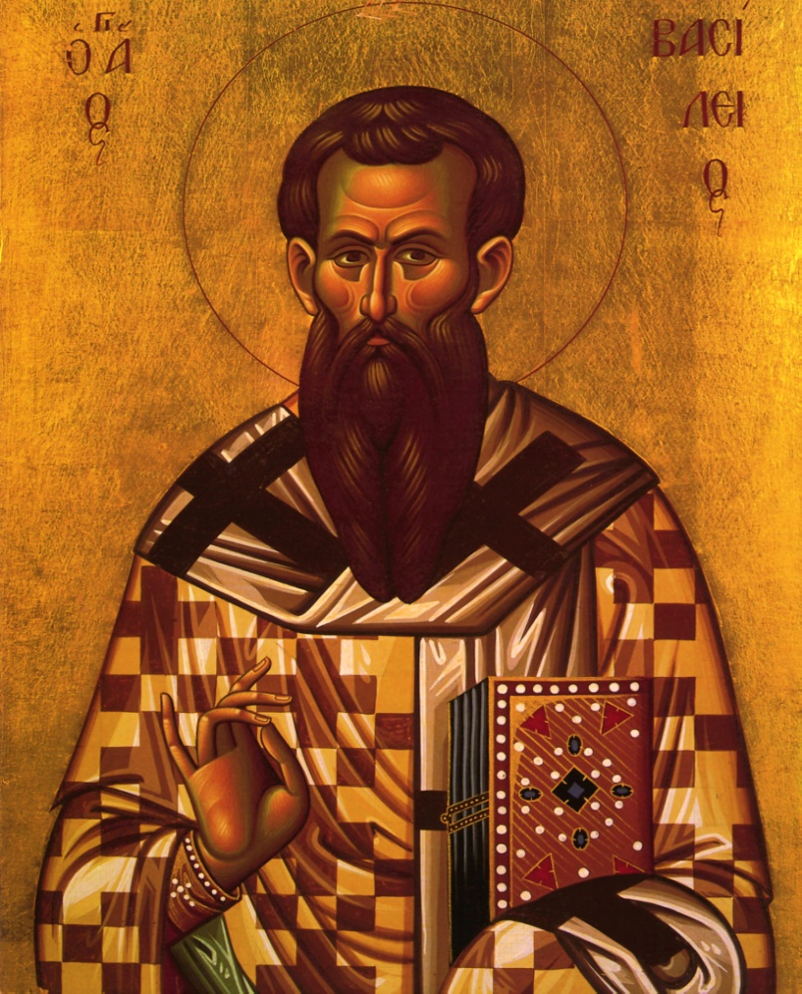
The Trinity
Icon of St. Basil the Great
The Father is God
The Son is God
The Holy Spirit is God
The Father is not the Son.
The Son is not the Holy Spirit
The Holy Spirit is not the Father
There is One God!
Notes:
St Basil the Great: Founder of modern hospitals; father of monasticism; and author of “On the Holy Spirit”, a great treatise defending the Holy Spirit as one of the Trinity. He too is one of the Greek Doctors of the Church.
We have the most famous exposition of the Trinity. Seven statements that can’t all be true, but are true. There are many others.

Slide 13
St. Basil the Great
Born in Cappadocia in 329 or 330.
Brother of St. Gregory of Nyssa, and St. Macrina. Life-long friend of St. Gregory the Theologian
Founder of orphanages and hospitals.
Monastic Rule
Famous Writings include:
  On the Holy Spirit
  Refutation of Arianism
  On the Spiritual Life
Authored the Liturgy of St. Basil.
Defended the Faith against the Arian Roman Emperor Valens
Notes:
St. Basil had a pretty full life: he authored the Divine Liturgy that we use ten times a year. The Liturgy of St. John Chrysostom is a shorter version of this Liturgy. He wrote the monastic rule that is still in use today. There is the Shorter Rule, and the Longer Rule. The Shorter Rule is actually longer than the Longer Rule. In any event, this is still the rule used today by Eastern monastics and many in the West. He was an archbishop governing a large province. He was a key defender of the Faith. He was a brilliant writer, and composer of many prayers still used today. He is regarded as the modern founder of hospitals. There are many reasons why we call him Great.

Slide 14
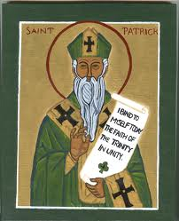
Another Attempt to Explain It…
Icon of St. Patrick
Here is the one we most commonly used in the West: The Clover of St. Patrick.
But no matter what, it still remains a central mystery.
All human words fail when we attempt to describe God.
Notes:
St Patrick said the Trinity is like a clover leaf—one plant, but with three leafs. There are several others in the workbook.

Slide 15
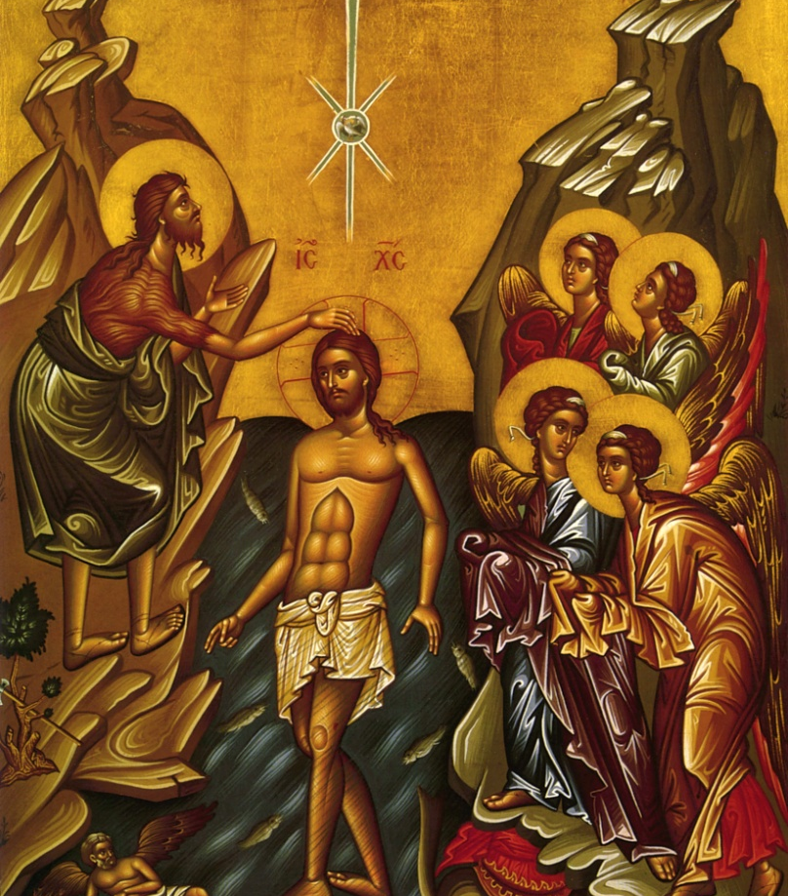
Where is That in Scripture?
Baptism in the Jordan (Mt. 3:16-17, Lk. 3:21-22)
The Great Commission (Mt. 28:19)
Don’t forget about the writings of the Fathers, especially St. Basil.

Slide 16
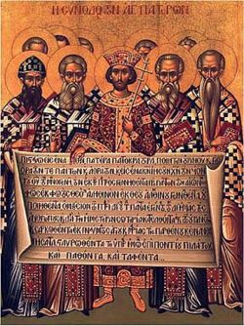
The Creed
Icon of the First Ecumenical Council
We not only believe in the Creed, we PRAY the Creed at every Divine Liturgy
How does the Creed we use differ from the Creed used in the Western Church?
Notes:
The difference in the Creeds between the East and the West is dealt with in detail in your workbook. Suffice it to say, the major difference is the phrase “and the Son”. (cf. John 14:16) Either form of the Creed has long since been deemed acceptable by the Catholic Church.

Slide 17
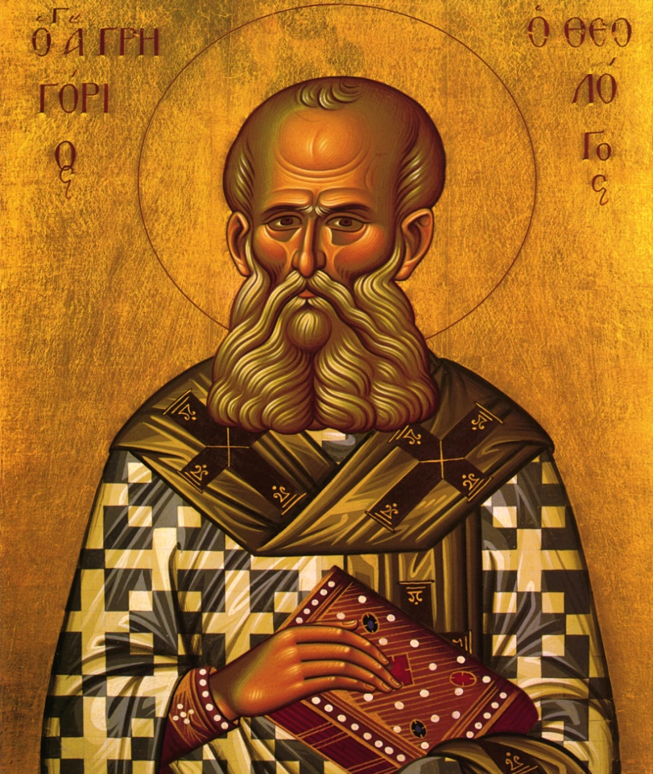
The Development of the Creed
St. Gregory the Theologian
First and Second Ecumenical Councils
The Eastern Church was a leading force in the development of the Creed.
We bless ourselves at every mention of the Trinity.
Notes:
St Gregory the Theologian was a Third Greek Father of the Universal Church. He was a tireless opponent of the Arian heresy, and he presided at the second Ecumenical Council in 381.

Slide 18
Where Did Some People Go Wrong?
Heresy is an attempt to take one Person out of the Trinity and try to make it more logical and understandable.
Your workbook has a list of some of the heresies over the millennia.
Examples in Real Life:
  A Tug of War
  A train on parallel tracks
  The Keystone of an arch
The Mystery of the Trinity is not a detective novel. It is not solved
Notes:
Catholic and Orthodox Faith requires a tension. If Person in the Trinity is distorted, the Faith falls. Think of it as a three sided tug of war. Everyone is pulling with the same strength, so everything is in dynamic balance. Suppose one side lets go though. Then the other two sides fall down.
Suppose one of the Angels in the icon of the Trinity ceased looking at the other. We would have discorc.
A train has to travel on parallel tracks. If it does not, the train derails.
If the Keystone of the arch is taken away, the whole structure fails. That is like our Faith. That is why we need to keep balance.
The Eastern Church strives to maintain balance in its faith—each member of the Trinity and the Theotokos. Look at the icons,and their requirements.
Even icons have special rules to keep the balance. For instance, the Theotokos is never presented along with two exceptions. Her position to the Faith is always relative to that of her Son, the Second Person in the Trinity.

Slide 19
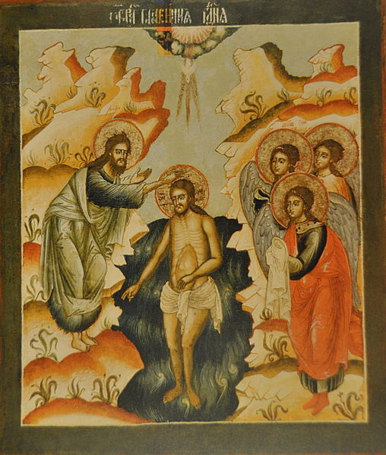
Baptism
The Baptism of Jesus
What does the Priest ask at Baptism?
Do You Believe in the Father, Son, and Holy Spirit?
Note the importance of Baptism in the Creed.
Notes:
The icon of the Baptism of Jesus, which worship of the Trinity was revealed. Jesus can be depicted in icons because he was a man. The Holy Spirit is always portrayed as a dove. God the Father, whose voice we only heard, is never portrayed except in rare incidents

Slide 20
St. Gregory the Theologian
Commemorated on January 25, and on January 30, the Feast of the Three Holy Hierarchs
Patriarch of Constantinople in 379
Presided over the Second Ecumenical Council in 381
Met Basil the Great in Athens, a great center of Western Culture. Lifelong friend.
Defender of the Trinity and opponent of Arianism.

Slide 21
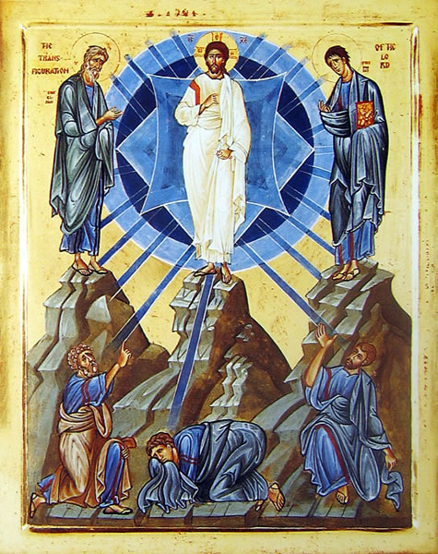
Next Week
Icon of the Transfiguration
Faith In Jesus
Have a Great Week!
And don’t forget your reading assignments!
Notes:
We close today with the Icon of the Transfiguration, celebrated on August 6. This is yet another Theophany, and give us the question: “Who do you say Jesus Is?”

Slide 22
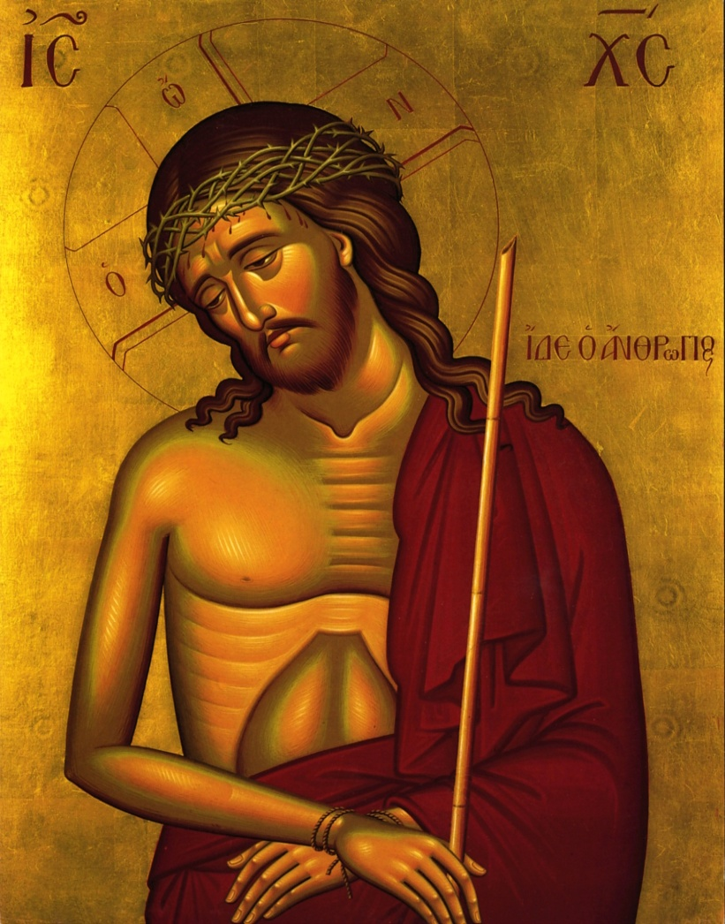
Class 2—Faith in Jesus
Notes:
Icon of Extreme Humility, something to contemplate as we continue on our course of studies.

Slide 23
Class 2—Opening Prayer
Heavenly King, Comforter, Spirit of Truth, everywhere present and filling all things, Treasury of Blessing, and Giver of Life, come and dwell within us, cleanse us of all stain, and save our souls O Gracious One!
Holy God, Holy and Mighty, Holy and Immortal, have Mercy on Us. Holy God, Holy and Might, Holy and Immortal, have Mercy on Us. Holy God, Holy and Mighty, Holy and Immortal, have Mercy on Us.
Glory to Jesus Christ!
Notes:
Our second prayer is yet again a second prayer to the Trinity. It is known as the Trisagion, or the Thrice Holy Hymn.

Slide 24
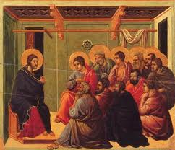
The Background
Icon of Jesus Teaching his Disciples
Rabbis taught by citing the writings of other rabbis.
Jesus was especially critical of the Pharisees (Mt. 23: 1-35).
They observed tradition while ignoring the deeper requirements of God.

Slide 25
Faith in Jesus
The Torah doesn’t have just 10 Commandments, it has 613!
The Pharisees added a “fence around the Law” which expanded the Law.
He makes claims about his own person.
Jesus is an object of human faith.
He is not just a miracle worker or a prophet.
We make an act of faith to have a personal relationship with Jesus.
Notes:
Keep in mind the requirements of the Law. We will come back to them in the fourth lessaon.

Slide 26
His Death
We embrace the Crucifixion and Resurrection of Jesus.
It was not an embarrassment to the earliest Christians.
We remember the Cross throughout the Church Year.
“We preach Christ crucified, a stumbling block to Jews and folly to the Gentiles.” (1 Cor. 2:23)
“… Be it for me to glory except in the Cross…” (Gal. 6:14)
Other readings: Rom. 6:1-8; 1 Cor. 11:26; Phil. 2:6-8)
Notes:
It was precisely his death that prevented the Jews from accepting Jesus as the Messiah. Leviticus curses the man hung on a tree. As one Biblical Scholar put it, for the Jews to accept Jesus as the Messiah would be like us accepting David Koresh as the Messiah. He was killed also by the authorities. Lucky for us, he was not the Messiah.
We remember the Cross on Wednesdays and Friday, and in a Special way, on Good Friday. Other major feast days associated with the Cross are August 1 (the Procession of the Cross) and September 14 (the Exaltation of the Cross). Just as a side note, the Exaltation of the Cross continues on the Roman Calendar as a solemnity, so the vestment color is red if that day falls on a Sunday.

Slide 27
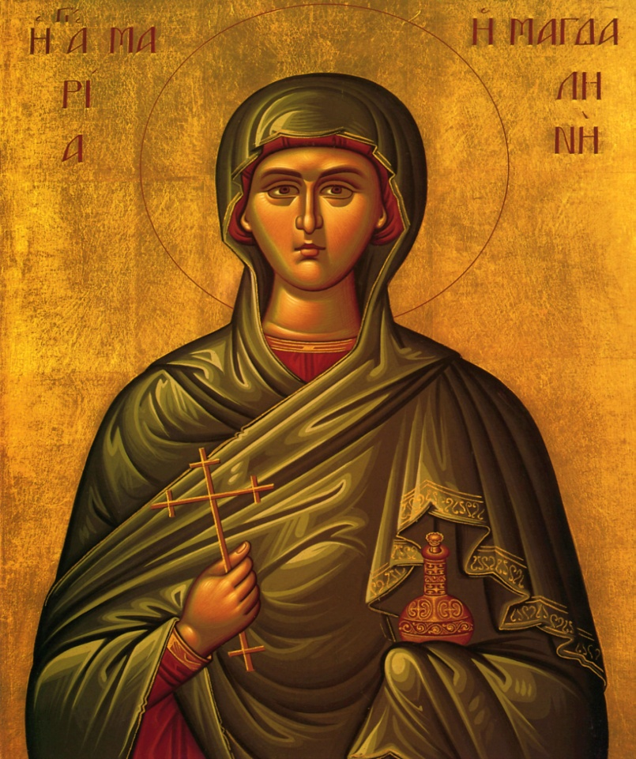
His Resurrection
Icon of Mary Magdalene
Even the early Christians had problems believing.
What does Mary Magdalene think after the Resurrection? (Jn. 20:15-16)?
What do the Apostles think? (Mt. 28:17)
Notes:
Mary does not recognize Jesus with his Resurrected body. She is accorded the title of “Equal of the Apostles” and her feast day is July 22. There has been a lot of strange speculation about her in recent years. All of it is not worth the paper it is written on.

Slide 28
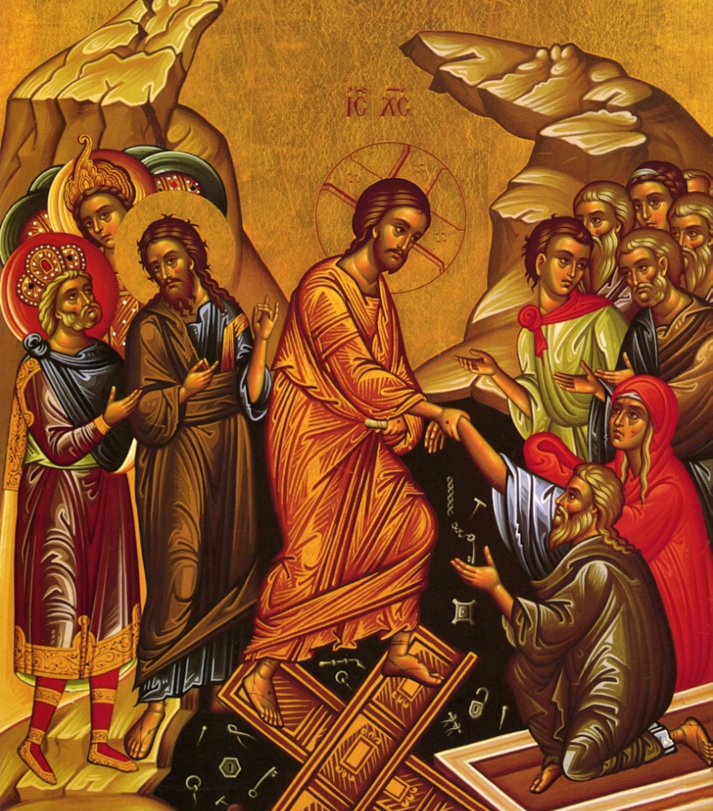
His Resurrection
St Paul says without the Resurrection Christianity is reduced to an absurdity.
It is not only his Death, but also his Resurrection that reconciles us to God.
Death is Trampled!
Notes:
St. Athanasius: God became Man so that Man could become God. Jesus is resurrected in his Divinized Body, and we say in the creed: I believe in the Resurrection of the Dead. He is indeed the New Adam, and the First Fruits of Things to Come. This is illustrated by the icon of the Raising of Lazarus. Remember though, the raising of Lazarus was not the same as the Resurrection of Jesus. Lazarus did die. Obviously, he is not walking the earth now! It is the Resurrection of Jesus that is unique as He was raised in his Resurrected body, which is part of our faith. We too will be raised to our Glorified bodies at the end of time.

Slide 29
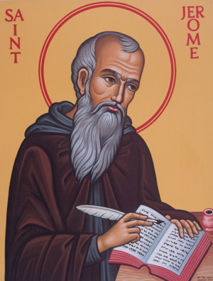
Were There Unbelievers? Sure.
Saint Jerome remarked that the world "awoke with a groan to find itself Arian."
And let them not flatter themselves if they think they have Scripture authority for their assertions, since the devil himself quoted Scripture, and the essence of the Scriptures is not the letter, but the meaning. Otherwise, if we follow the letter, we too can concoct a new dogma and assert that such persons as wear shoes and have two coats must not be received into the Church
Notes:
St. J

Slide 30
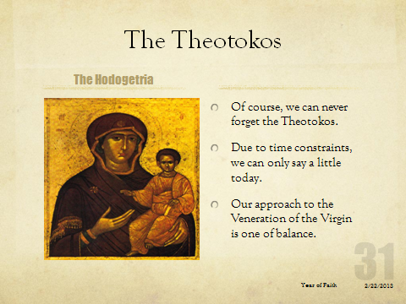
Notes:
This version of the icon shows the Virgin pointing to her son.

Slide 31
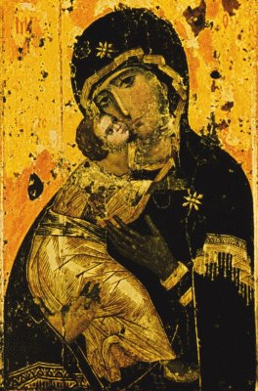
The Theotokos
Virgin of Vladimir
The Theotokos in Icons
With some rare and well known exceptions, the Virgin is always portrayed in relation to her Son.
Our prayers and services also reflect this balance.
Notes:
Probably the best known icon of the Virgin.
What are the exceptions? The Icon of the Annunciation, of which there are seven variations

Slide 32
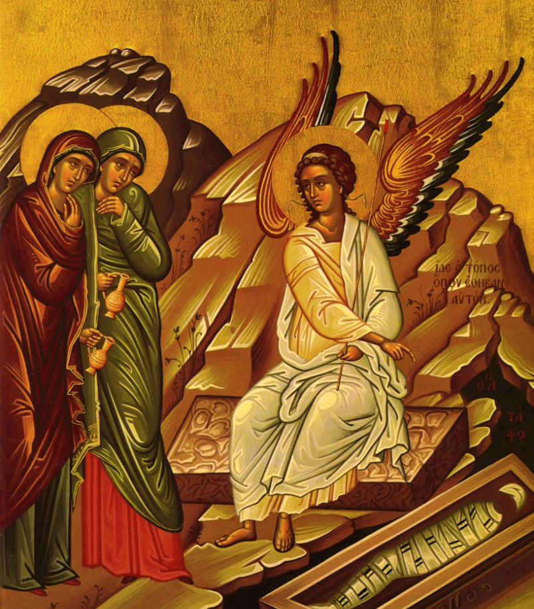
Next Week
Faith and Conversion Stories
Have a safe week!
Don’t forget to do your reading!
And don’t forget to pray!
Icon of the Myrrh Bearers
Notes:
WE close today with the icon of the myrhhbearers. St. Mark says they ran from the tomb and told no one because they were afraid. Yet, they did, because we are here today. They overcame their initial fear, and they believed. Today, it is not so much fear that prevents us from believing, but doubt and skepticism. It is our duty as Christians to overcome them, just as Christ overcame death.

Slide 33
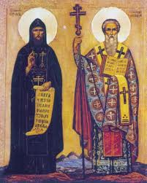
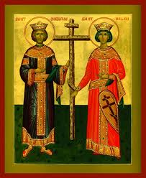
Class 3—Faith and Conversion
Sts. Cyril and Methodius
Ss. Constantine and Helena
Notes:
St. Cyril and Methodius, the Apostle to the Slavs, who converted Eastern Europe.
St. Constantine, the first Christian Emperor. His conversion led to the Christianization of the Empire. This year is the 1700th anniversary of the Edict of Milan, which provided for the toleration of Christianity. Like Abraham Lincoln, a lot of nonsense has been written about Constantine in the last couple decades. This too is not worth the paper it is written on.

Slide 34
Class 3—Opening Prayer
Heavenly King, Comforter, Spirit of Truth, everywhere present and filling all things, Treasury of Blessing, and Giver of Life, come and dwell within us, cleanse us of all stain, and save our souls O Gracious One!
Holy God, Holy and Mighty, Holy and Immortal, have Mercy on Us. Holy God, Holy and Might, Holy and Immortal, have Mercy on Us. Holy God, Holy and Mighty, Holy and Immortal, have Mercy on Us.
Glory to the Father, and to the Son, and to the Holy Spirit, now an ever and forever, Amen.
Oh Most Holy Trinity, have mercy on us. Lord, cleanse us of our sins. Master, forgive our transgression; Holy One, come to us and heal our infirmities for Your name’s sake.

Slide 35
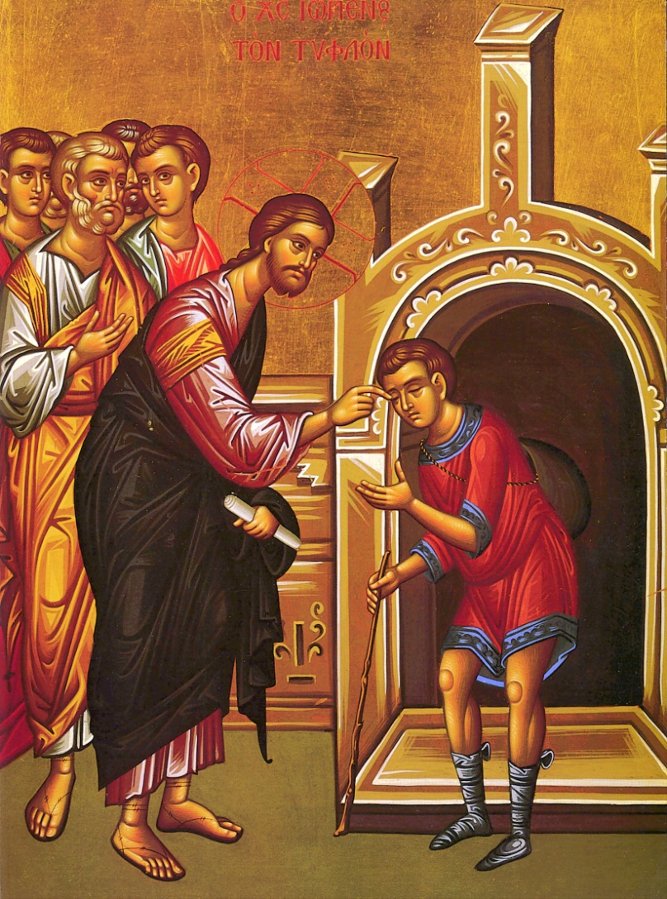
Bartimaeus
Mark 10:46-52
He cried out “Jesus, Son of David Have Mercy on Me!”
As the crowd tried to silence him, Bartimaeus cried out all the louder.
This is why we repeat “Lord Have Mercy” so many times in the Divine Liturgy.
Notes:
We cry out all the more insistently during the Divine Liturgy. In the litany at the beginning of the Divine Liturgy, we pray “Lord have Mercy” only once per petition. As we go on, we pray it three times per petition.

Slide 36
Faith of Bartimaeus
He was insistent.
He was consistent.
He was resistant.
Bartimaeus kept asking for the Mercy of God, as we should.
He kept to his message.
Bartimaeus resisted the crowd that tried to silence him.
DO WE LET THE CROWD SILENCE US?

Slide 37
Bartimaeus
He was bold in his faith. He asked Jesus for his sight (Mark 10:51). We need to ask when we pray.
He could have left, but he chose to follow Jesus.
DO WE MAKE THAT CHOICE?
Look where the story of Bartimaeus is in the Gospel of Mark.
He could have seen Palm Sunday, the Crucifixion, and the Resurrection.
Notes:
The story of Bartimaeus is directly before the Passion. Bartimaeus could have been an eyewitness of all that has transpired.

Slide 38
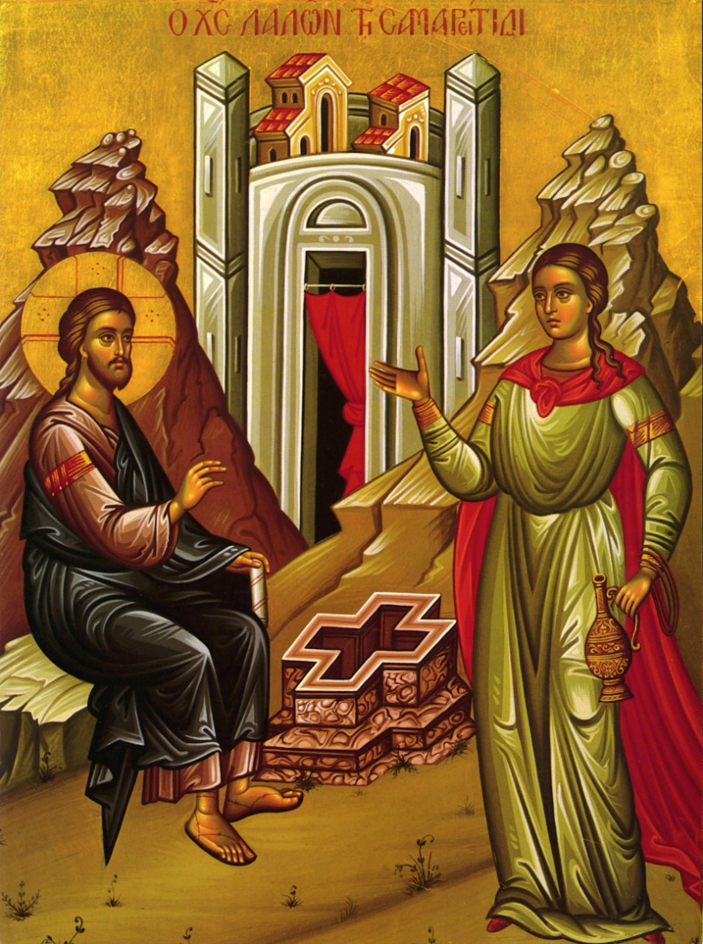
The Samaritan Woman
John 4: 1-42
A woman with a “checkered” past.
She goes to the well at an odd time. WHY?
WHY does she say “Sir, I perceive you are a prophet.”
Notes:
St. Photini, as she is known in our tradition, goes to the well at an odd time because she is probably a social outcast.
When jesus points out there were some, shall we say, marital issues, she coyly responds Sir you are a prophet. She doesn’t agree with Jesus right away, but eventually does.

Slide 39
The Samaritan Woman
THEOLOGICAL DISCUSSION
SO WHAT HAPPENS?
“You will worship the Father…”
“Salvation is from the Jews…”
“Living Water”
IT IS NOT ONLY THE PROPHECY THAT CONVINCES HER, BUT THE INTELLECTUAL DISCUSSION AS WELL.
“He told me all that I ever did.”
“It is no longer because of your words that we believe, for we have heard ourselves, and we know this is indeed the Savior of the world…”
HOW DO WE DEVELOP INTELLECTUAL ASSENT?
Notes:
There are many things going on in the story of the Samaritan woman, but I want to focus an just one here. There is a wonderful theological debate. She engages jesus with her intellect, and this, along with the Prophecy leads to her conversion.
The intellect is not the only way for us to achieve conversion, but it is important.
We develop our intellectual assent by studying our faith. As we learn more, our faith will deepen.

Slide 40
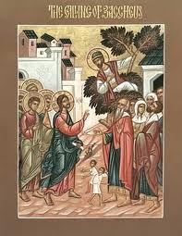
Zacchaeus
Luke 19:1-10
WHAT IS HIS STORY?
WHAT DOES EXODUS 22:1 REQUIRE?
HOW DO YOU READ LUKE 19:8?
Notes:
Exodus 22 is the most strict of the restitution provisions. It requires the return of four times what was stolen. In other places, the Law requires only a 20% premium.
Luke 19:8 has been read by many to be forward looking, rather than in the past tense. In any event, Zaccheus makes a commitment tp be honest in his dealings.

Slide 41
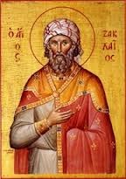
Zacchaeus
He makes a vow to work on his faith.
His faith includes action: restitution.
THE STORY OF ZACCHAEUS BEGINS THE LENTEN CYCLE. DO WE WORK ON OUR FAITH AS ZACCHAEUS DID?
Icon of Zacchaeus
Notes:
We too our called to act. The modern equivalent to the actions of Zaccheus are confession, penance, and contriteness. Zaccheus also in effect gives alms by restoring four fold.

Slide 42
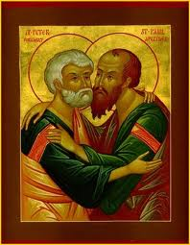
St. Peter
“Depart from me, for I am a sinful man” (Luke 5: 8)
Peter is not a notorious sinner, yet he realizes his unworthiness to be with Jesus. DO WE?
Peter chose to walk with Jesus nonetheless. DO WE?
Icon of St. Peter and Paul
Notes:
This icon of St. Peter and Paul has great ecumenical significance. St. Peter was the bishop of Rome, and his brother Andrew is the patron of Constantinople.

Slide 43
What Do These Stories Tell Us About Our Faith?
We must be insistent, consistent, and resistant.
We must work to develop our understanding of our Faith.
We must ACT on our Faith.
We must recognize our unworthiness before God, but walk with Him.

Slide 44
Next Week…
We will discuss one of the most difficult topics in all of Christianity: Faith and Works.
Please do your Readings!
We will work hard next week!
Drive safely, and have a great week!

Slide 45
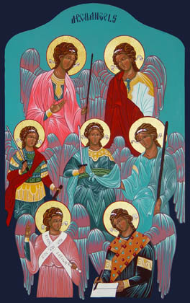
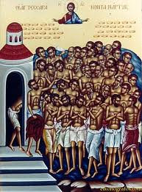
Class 4-Faith and Daily Life
Notes:
Sometimes we think of our faith as being totally different from our normal lives. For instance, the icon of the seven archangels. We don’t see angels around a lot. Or the 40 martyrs of Sebaste who were frozen on a lake. WE don’t see too many martyrs her in American. So how does our Faith connect to our lives?
PS extra credit to all those who can name the Seven Archangels.

Slide 46
The Seven Archangels
Michael (Sunday)
Gabriel (Monday)
Raphael (Tuesday)
Uriel (Wednesday)
Selaphiel (Thursday)
Jegudiel (Friday) and
Barachiel (Saturday).
The First Three are named in the Bible.
The Book of Tobit says there are Seven Archangels that stand before the Throne of God.
Remaining four names are from tradition.

Slide 47
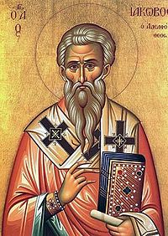
Faith and Works?
Read James 2:14-26
“So Faith by itself, if it has no works, is dead…”
“You see that a man is justified by works and not faith alone.”
“…so Faith apart from works is dead.”
James, the Brother of Jesus

Slide 48
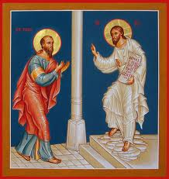
Faith and Works
Read Romans 4:1-8
WHAT DOES ST PAUL SAY ON THIS SUBJECT?
WHAT IS GOING ON HERE? HOW DO WE SQUARE THESE TWO SEEMINGLY DIFFERENT VIEWS?
Paul encountering Jesus
Notes:
St. Paul seems to entirely rely on faith for our salvation. However, the two views can and have been reconciled. This is the icon of St. Paul encountering Jesus. A key to our Faith is also how we encounter Jesus.

Slide 49
It is All in the Definitions…
FAITH
FAITH
HOW DOES ST PAUL SEEM TO DEFINE FAITH?
HOW DOES ST. JAMES SEEM TO DEFINE FAITH?
THE KEY TO UNDERSTANDING IS THE TIMING. ONE SPEAKS OF FAITH IN THE ROLE OF CONVERSION, AND THE OTHER FAITH AFTER CONVERSION.
ARE THEY REALLY AS FAR APART AS THEY SEEM?

Slide 50
It is All in the Definitions…
WORKS
WORKS
HOW DOES ST. PAUL SEEM TO DEFINE WORKS?
HOW DOES MARTIN LUTHER SEEM TO DEFINE WORKS?
HOW DOES ST. JAMES DEFINE WORKS?
OLD TESTAMENT “LAW”
AS SACRAMENTS AND OTHER CHURCH ACTIVITY.
AS WE WOULD THINK OF WORKS, ACTS OF CHARITY.
Notes:
Christianity has kept the moral law but not the ritual laws.

Slide 51
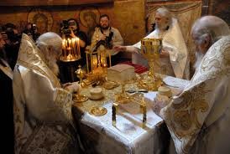
What is the Purpose of Worship?
Your workbook has description of our various types of worship.
God does not need our worship. We do.
This is how we celebrate and deepen our faith.
Notes:
We worship to deepen our faith.

Slide 52
Why Do We Pray?
In the Eastern Church, Faith gives rise to Worship which then gives rise to Theology.
Prayer is fundamental to our Theology and Faith.
It is a giant feedback loop!
“Theology is Faith seeking Understanding.”
Prayer
Worship
Faith

Slide 53

Where Have Seen This Before?
“Theology is Faith seeking Understanding. “
Theology
Prayer
Faith

Slide 54
How Do We Pray?
Every Good Prayer includes the following:
  Adoration or Praise of God.
  Contrition for our sins.
  Thanksgiving for all the Lord has given us.
  Supplication—We ask God for what we need.
Our prayer should be insistent, consistent, and resistant.
Our prayer should contain ACTS.
We should strive to understand our prayers, and to experience as many prayer services as we can.

Slide 55
Didache—Chapter 8
But let not your fasts be with the hypocrites, for they fast on the second and fifth day of the week. Rather, fast on the fourth day and the Preparation Day (Friday). Do not pray like the hypocrites, but rather as the Lord commanded in His Gospel… like this:
Our Father who art in heaven, hallowed be Thy name….for Thine is the power and the glory for ever…
Pray this three times a day.
This is the simplest Christian prayer rule.
Notes:
The Didache is one of the earliest Christian documents, possibly written as early as the letters of St. Paul. Did you ever wonder why we fast on Wednesdays and Friday in Lent, or why we add the Doxology at the end of the Our Father?

Slide 56
So How Do We Deepen Our Faith in Everyday Life?
Alms, Prayer, and Fasting.
  Keep all Four Fast Periods, Fridays, and Holydays.
  Give to the Less Fortunate. It can be money or time.
Adopt a simple prayer rule and stick with it.
  Upon waking and upon going to bed.
  Morning, lunch, and evening.
  Memorize some simple prayers so you don’t need a book.

Slide 57
So How Do We Deepen Our Faith in Everyday Life?
Learn about your Faith.
  Read the Bible. Four chapters a day will cover the Book in two years!
  Read about the Faith.
  Don’t take things said on television or in the secular press as Gospel.
Practice Your Faith.
  One less TV program a week and come to Church instead!

Slide 58
The Christian Home
The Church is the Icon of the Trinity. The Family is the Icon of the Church.
Have an Icon corner. Make it easy to Pray.
Choose Saints you have a devotion to.
Keep your prayer book and other liturgical items there.
Should face East.

Slide 59
All Good Things Must Come To An End…
Your workbook has an evaluation. Our feelings will not be hurt. Please fill it out and hand them in on your way out or drop them in the collection basket, or mail them in.

Slide 60
ALL GOOD THINGS MUST COME TO AN END…
Please thank you for attending, and drive safely!

