Slide 1


THE SECOND ECUMENICAL COUNCIL
381 A.D.
Mark Koscinski CPA D.Litt.
Moravian University

Slide 2
Summary
Held in Constantinople in 381 A.D. when Theodosius the Great was Emperor
Attended by 150 eastern Bishops
Also known as the First Council of Constantinople

Slide 3
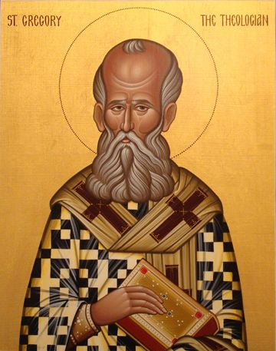
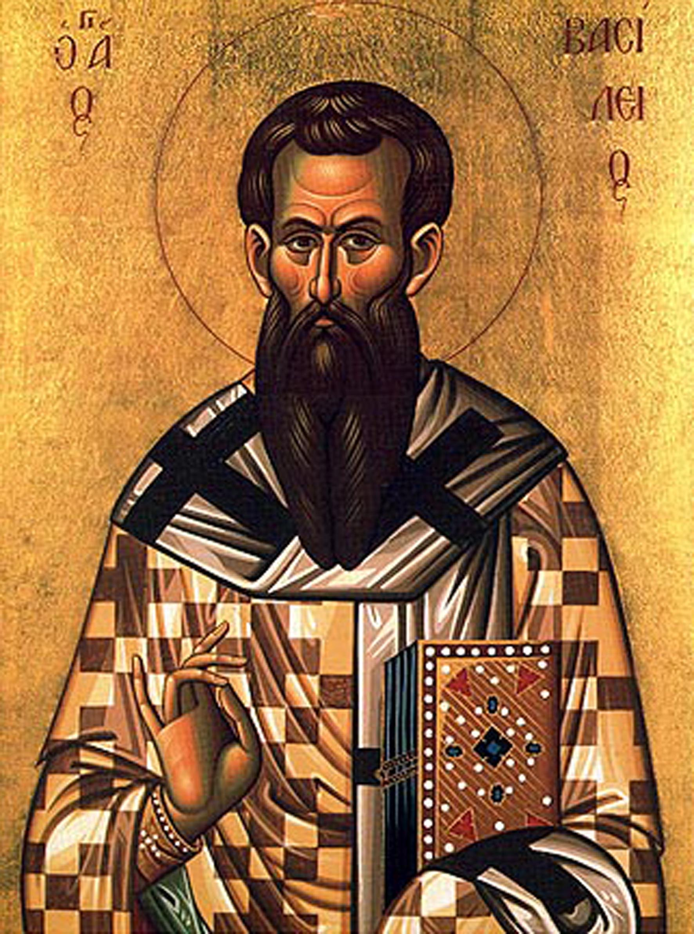
Ecclesiastical Luminaries
This Photo by Unknown Author is licensed under CC BY
This Photo by Unknown Author is licensed under CC BY-ND

Slide 4
Canons of the Second Ecumenical Council
Canon 1—Reaffirms the First Ecumenical Council and condemns all heretics including Arians, Sabellians, Appolinarians, etc.
Canon 2—Bishops are limited to their own territories.
Canon 3—Constantinople raised second to precedence after Rome
Canon 4—Maximus the Cynic was not a bishop (ordinations carried out in an irregular manner are not legitimate)

Slide 5
Canons of the Second Ecumenical Council
Canon 5—The “Tome of the Westerners” is accepted. No one is quite sure what this means.
Canon 6—Bishops could be accused in civil courts if the complaint was civil.
Canon 7—Reception of various heretics can be through chrismation. Others are received through baptism

