Slide 1

Windows to Heaven
Rev. Dr. Mark Koscinski
Moravian University

Slide 2
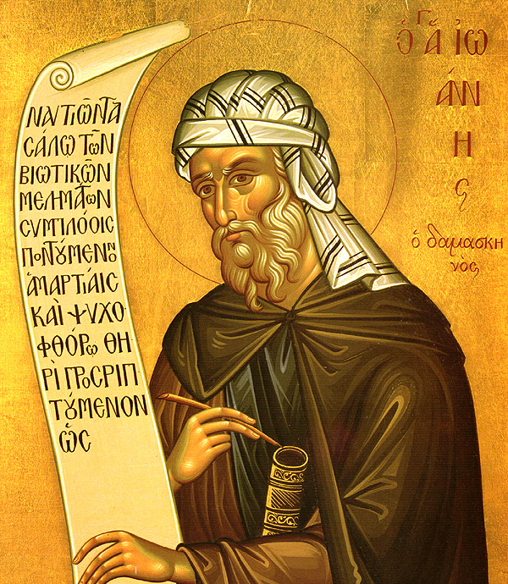
I. Introduction: Unveiling the Divine in Form
The Challenge: How to represent an invisible God? Old Testament prohibition against "graven images."
The Incarnation's Transformative Role: God became visible in Christ.
  St. John of Damascus: "Now when God is seen in the flesh... I make an image."

Slide 3
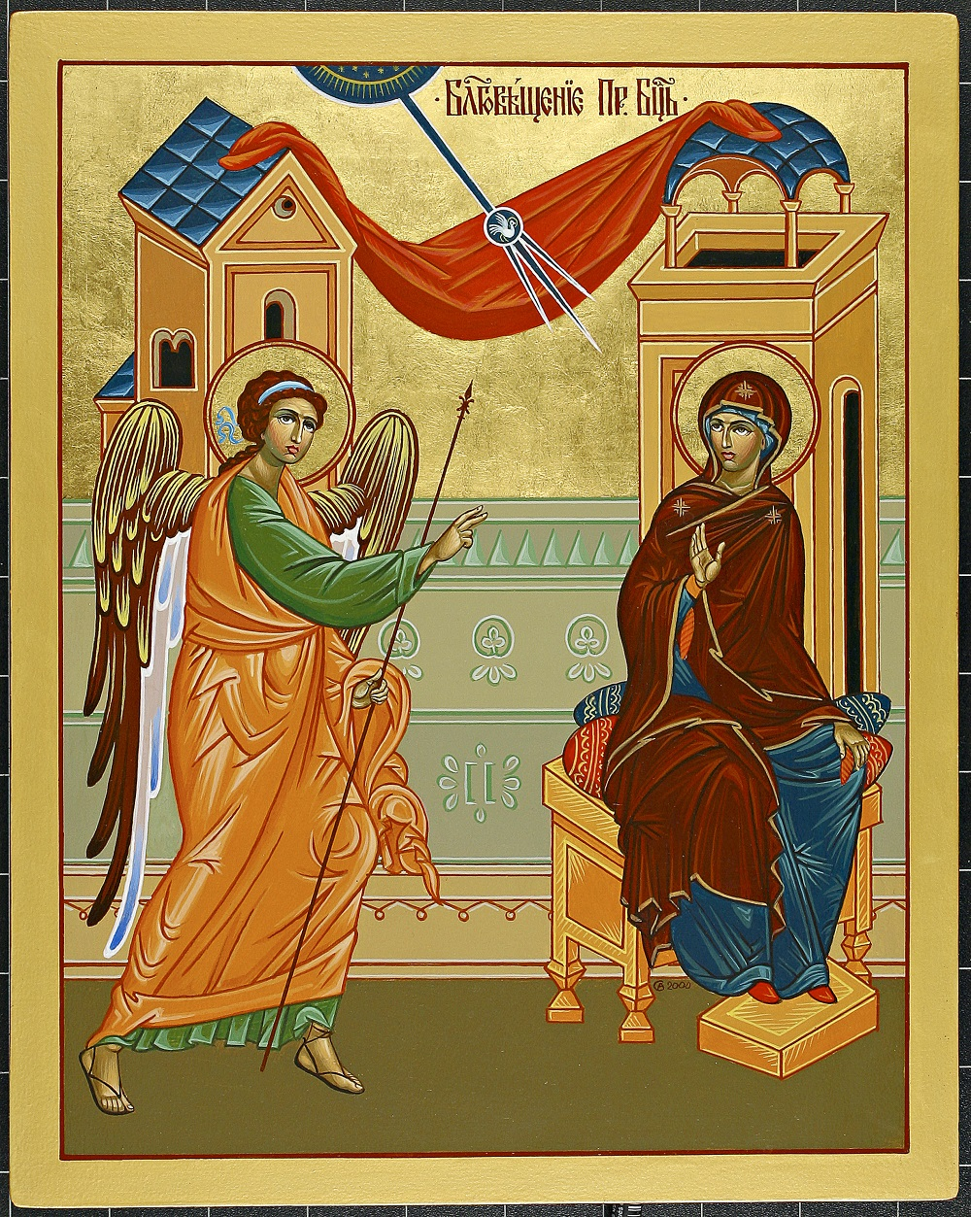
Introduction: Unveiling the Divine
Key Concepts:
  Incarnation: God becoming flesh in Jesus Christ (fully God, fully man).
  Iconography: Visual imagery and symbolism in religious art; "windows to the divine."
Thesis: Incarnation is the theological bedrock for Christian iconography.

Slide 4
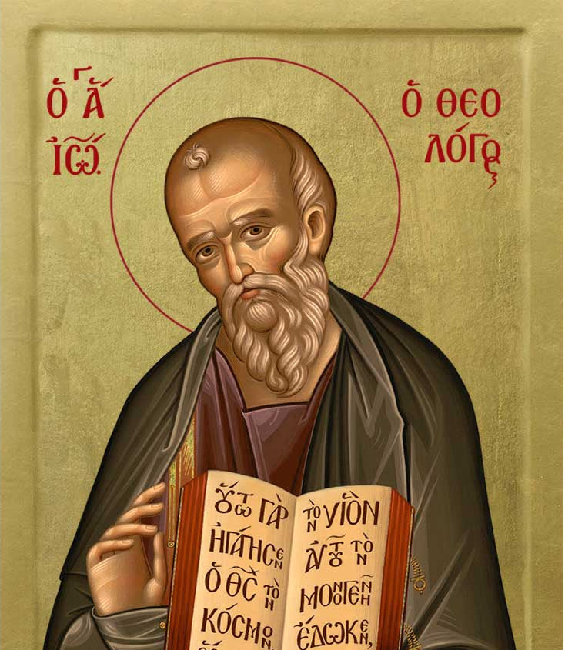
The Doctrine of the Incarnation
Definition: God Becoming Flesh in Jesus Christ (Fully God, Fully Man).
  Dual nature: divine and human, united in one person.
  Scriptural basis: 1 Timothy 3:16, John 1:14.
Theological Significance: Salvation and Reconciliation.
  Restoration of relationship with God.
  "Sacramentalization of matter": Material world elevated, allowing for icons as conduits.

Slide 5
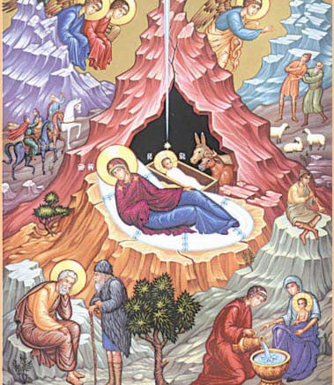
The Doctrine of the Incarnation
Biblical Foundations: Key Scriptural References.
  John 1:14 ("The Word became flesh").
  John 14:9 ("He that hath seen me hath seen the Father").

Slide 6
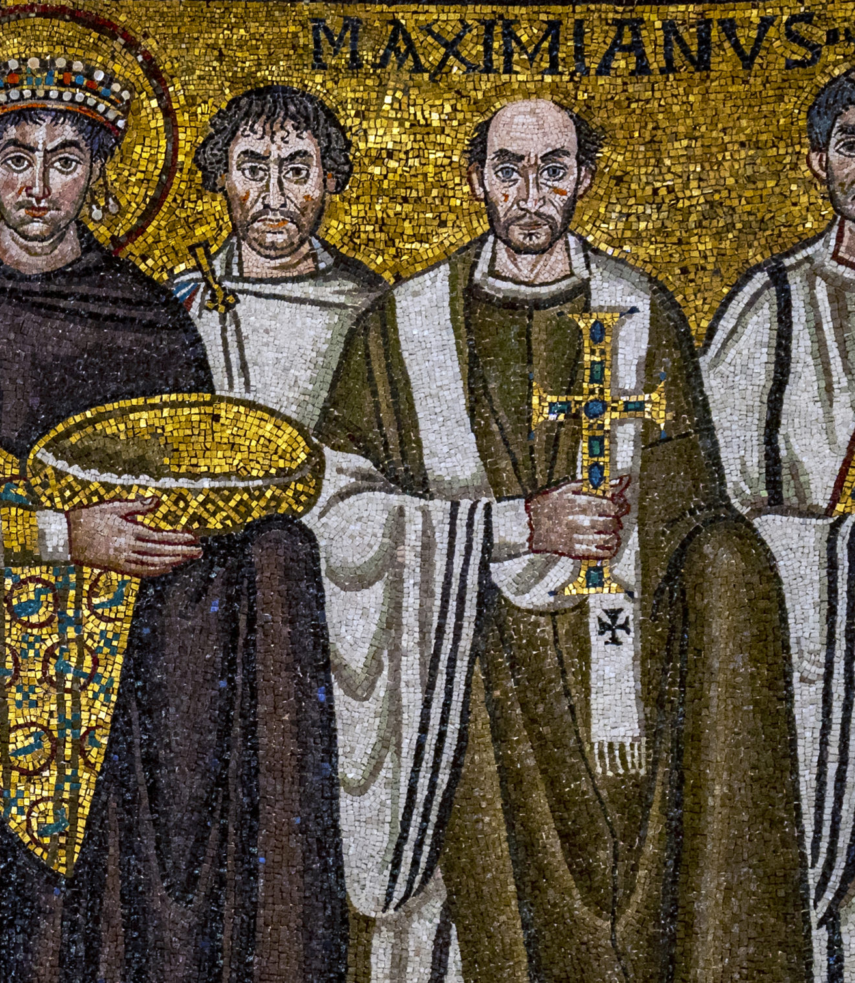
Christian Iconography: Windows to the Divine
Definition and Purpose: Visual Language of Faith.
  Communicates theology, narrates stories, aids worship.
  "Windows to the divine," educational tool (visual catechism).
Historical Development: From Early Symbols to Byzantine Tradition.
  Early Christian art: Furtive symbols (Ichthys, Lamb of God).
  Late Antique: Emergence of distinct Christian themes.
  Byzantine Empire: Integral to worship and teaching.

Slide 7
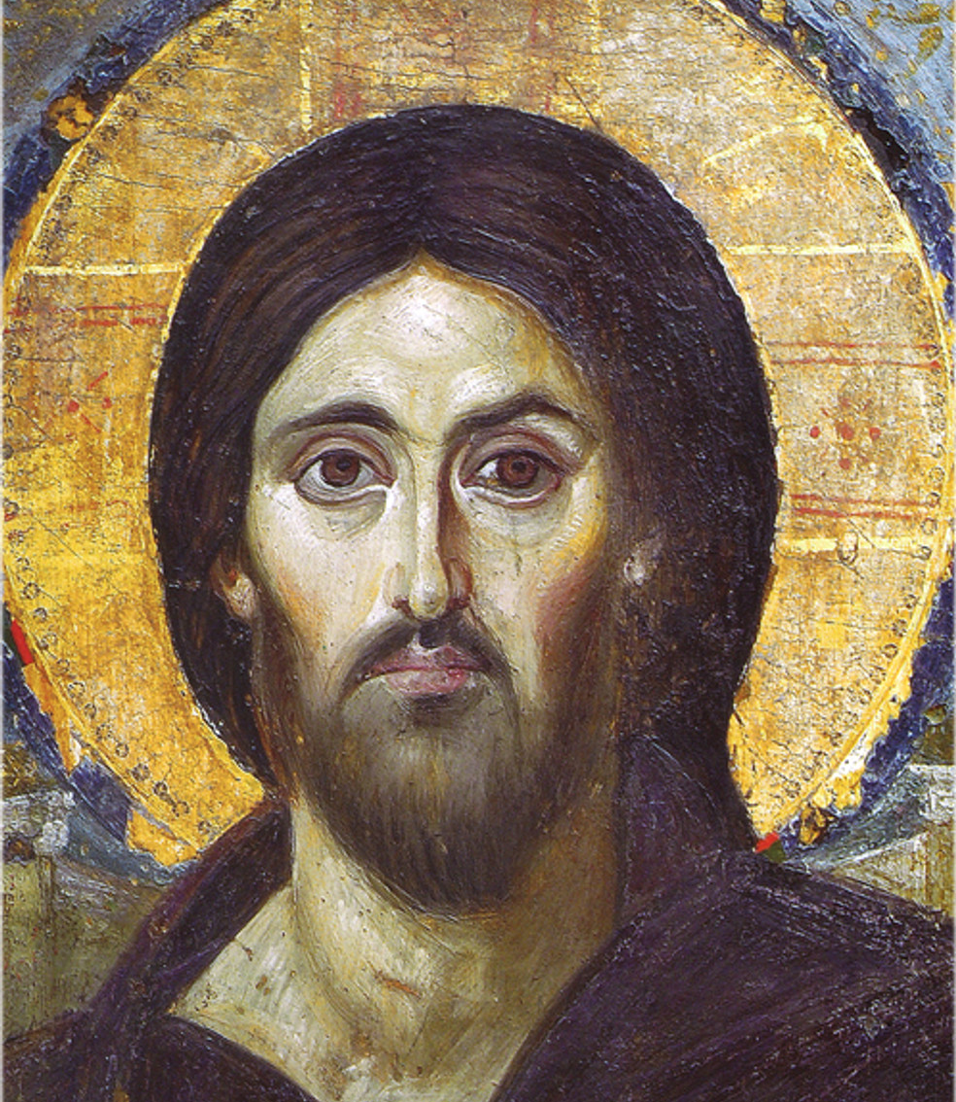
Christian Iconography: Windows to the Divine
Stylistic Characteristics of Byzantine Icons:
Stylized Figures (elongated, frontal, otherworldly).
Flattened/Reverse Perspective (draws viewer in).
Rich Colors and Symbolism (gold for divine light, specific color meanings).
Mandorlas and Halos (divine glory, sanctity).
Symbolic Gestures and Inscriptions.
Anti-naturalism: Purposeful choice to convey transcendent reality.

Slide 8
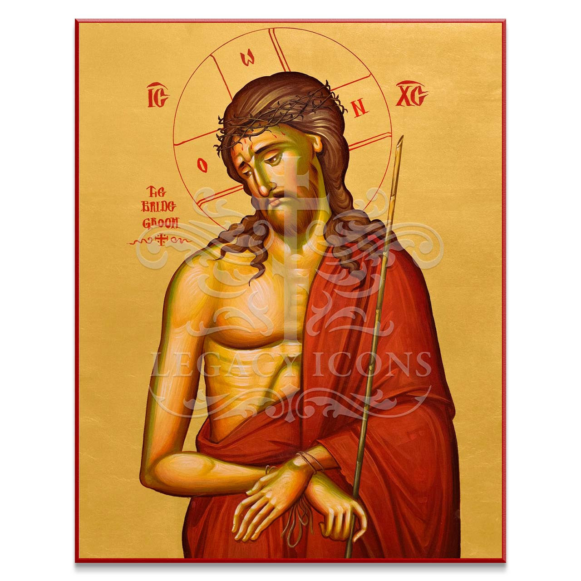
The Incarnation as Justification for Icons
The Core Argument: God Became Visible, Therefore Depictable.
Iconodules: Images affirm God's enfleshment.
  St. John of Damascus: "I make an image of the God whom I see."
  Counter-argument to idolatry: Prohibition against idolatrous use of images.
The Iconoclastic Controversies (8th-9th Centuries):
  Iconoclast Arguments: Old Testament prohibition, God invisible, Christological concerns (heresy).
  Iconodule Arguments: Incarnation changed premise, distinction between veneration and worship, honor passes to prototype.

Slide 9
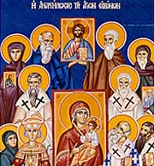
The Incarnation as Justification for Icons
. The Triumph of Orthodoxy: Second Council of Nicaea (787 AD).)
  Formal restoration of icons.
  Established distinction: timētikē proskynēsis (veneration) vs. alēthinē latreia (worship).
  Honor paid to icon passes to the prototype.

Slide 10
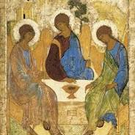
Conclusion
Summary: Incarnation is the foundational truth for Christian iconography.
Icons as: Tangible expressions of doctrine, aids to worship, tools for contemplation, visual catechisms.
Final Thought: Bridging the earthly and divine through the visible Christ.

